Slide 1
Health in Modern Day Society
James Horng
Jones 5th Period World History

Slide 2
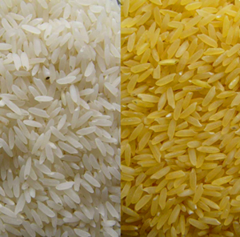
Franken-Food
Genetically Modified Food
Benefits of GM Foods
More Nutritious
Golden Rice: Provides Vitamin A
Reduce use of chemical insecticides
Disease resistant
Stronger plants

Slide 3
Fraken-food (cont.)
Higher crop fields
Medical benefits
Environmental benefits
New ingredients
Arguments against GM Foods
Threatens biodiversity
Addition of allergic substance that wouldn’t be there normally

Slide 4
United Nations Involvement
Approves of GM food
Watches it in case of allergic reactions

Slide 5
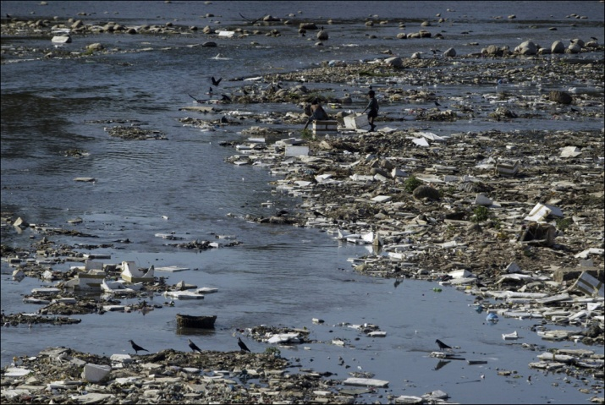
Water Problems
Polluted Water
Death by water > Death by violence
1/3 of world lacks adequate sanitation
Effective hygiene is not understood or impractical for many parts of world
Eutrophication
a result of high-nutrient loads which impairs the beneficial uses of water

Slide 6
Eutrophication
A result of high-nutrient loads which impairs the beneficial uses of water
Problems
Anoxia (lack of oxygen)
Sudden algal blooms
Decreased value of species
Less fish
Many more..

Slide 7
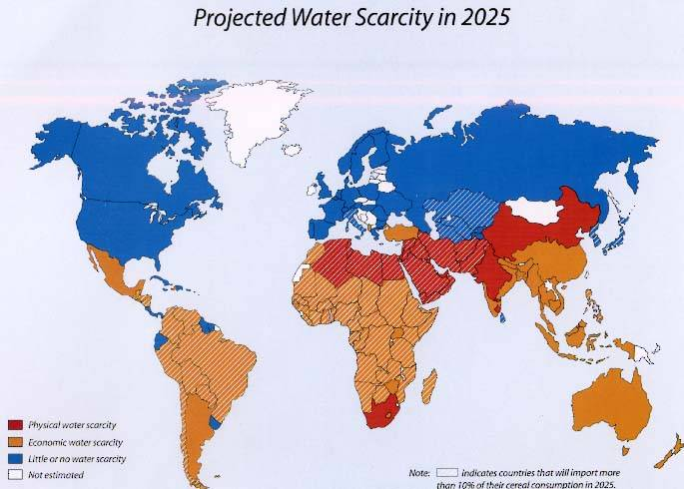

Slide 8
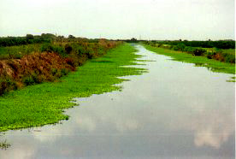
Eutrophication
Causes
Agriculture (fertilizers)
Factories
Sewage
Run off from rivers
Atmospheric deposition
Nitrogen fixation

Slide 9
United Nation Involvement
Human Right to Water and Sanitation
Every human being should have access to sufficient water
World Water Day (March 22)
UN-Water Taskforce on wastewater management

Slide 10
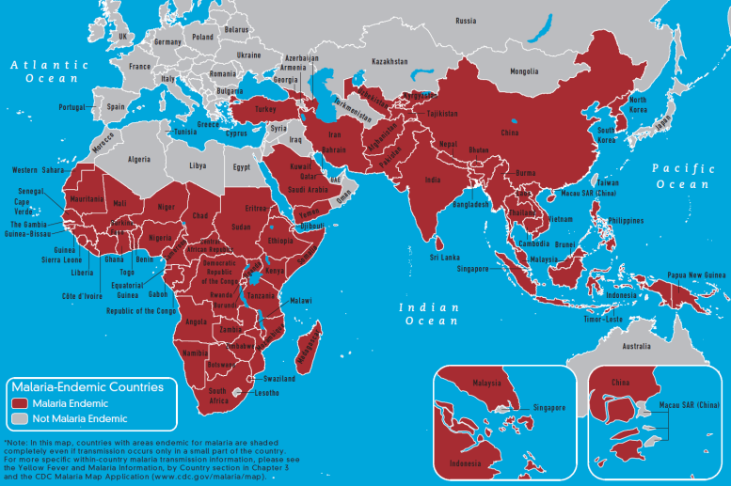
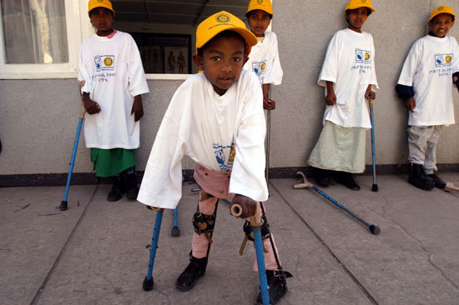
Health Issues
Death with Diseases
AIDS/HIV
Polio
Herpes
Cardiovascular diseases
Malnutrition
Malaria
Curable Diseases
Diabetes

Slide 11
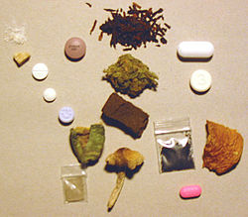
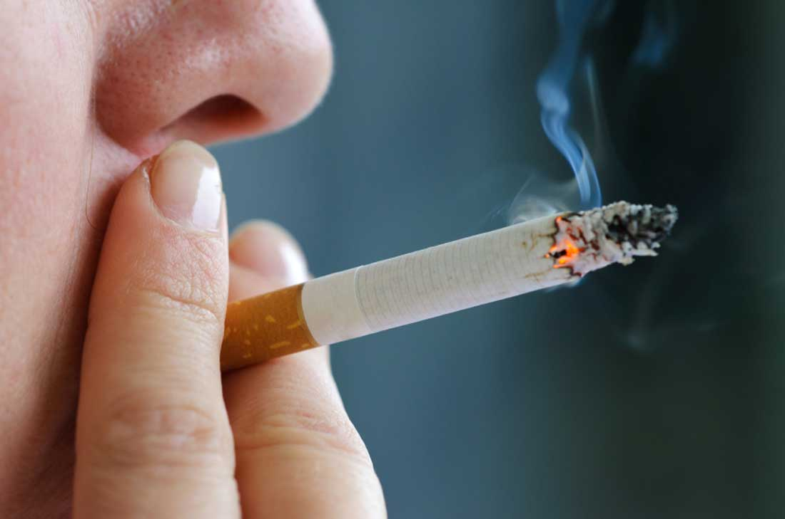
Health Issues
Activities
Smoking
Drinking
Drugs
> Billions lack health care
Food Safety

Slide 12
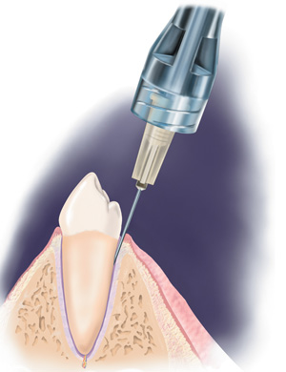
Improvements
Surgery
Anesthetic gas or injection
Sterile materials
Machines
Organ Transplant
Heart Shock
DNA
Human Genome

Slide 13
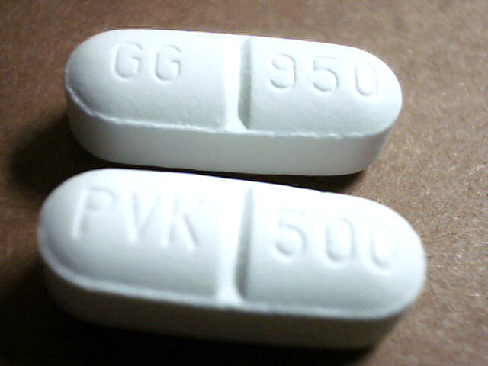
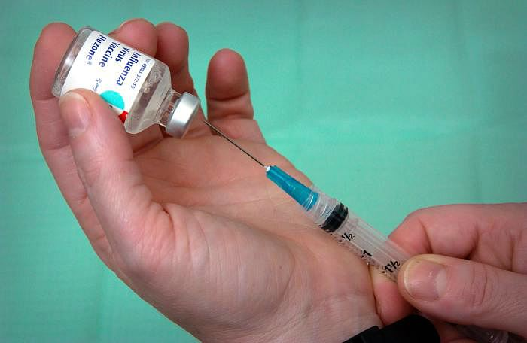
Improvements (cont.)
Steroids
Medicine
Penicillin
Vaccinations
Stopped diseases like
Smallpox
Varicella (chickenpox)
Diphtheria
Whooping Cough
Measles
Hepatitis B
HPV
Influenza

Slide 14
Health Care
Health Insurance Portability and Accountability Act
Helps people keep their health insurance
Americans with Disabilities Act (ADA)
Disability
Physical or mental impairment that limits one or more major activity
Record of such impairment
Being regarded as having such impairment

Slide 15
United Nation Involvement
World Health Organization (WHO)
Taken responsibility for International Classification of Disease
Attempting to eradicate disease
Smallpox
Yaws
United Nations Programme on HIV/AIDS(UNAIDS)
United Nations Population Fund (UNFPA)
United Nations Children’s Fund (UNICEF)

