Slide 1
The Protestant Reformation

Slide 2
Catholic Church Issues
Crusades – priests become politicians
Worldliness –church concerned w/ $$$$$$
Power Struggles (conflicts b/w popes)

Slide 3
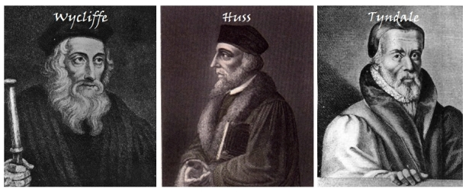
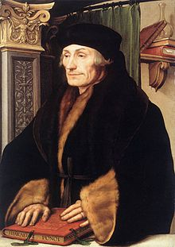
Early Reform
Wycliffe & Hus & Tyndale
  Criticize popes
  Translate Bible
Erasmus: Dutch Priest, Christian Humanist
  Spreads ideas to wider public
  Called for church reform & Bible in vernacular
NOT CALLING for a break from Catholic Church

Slide 4
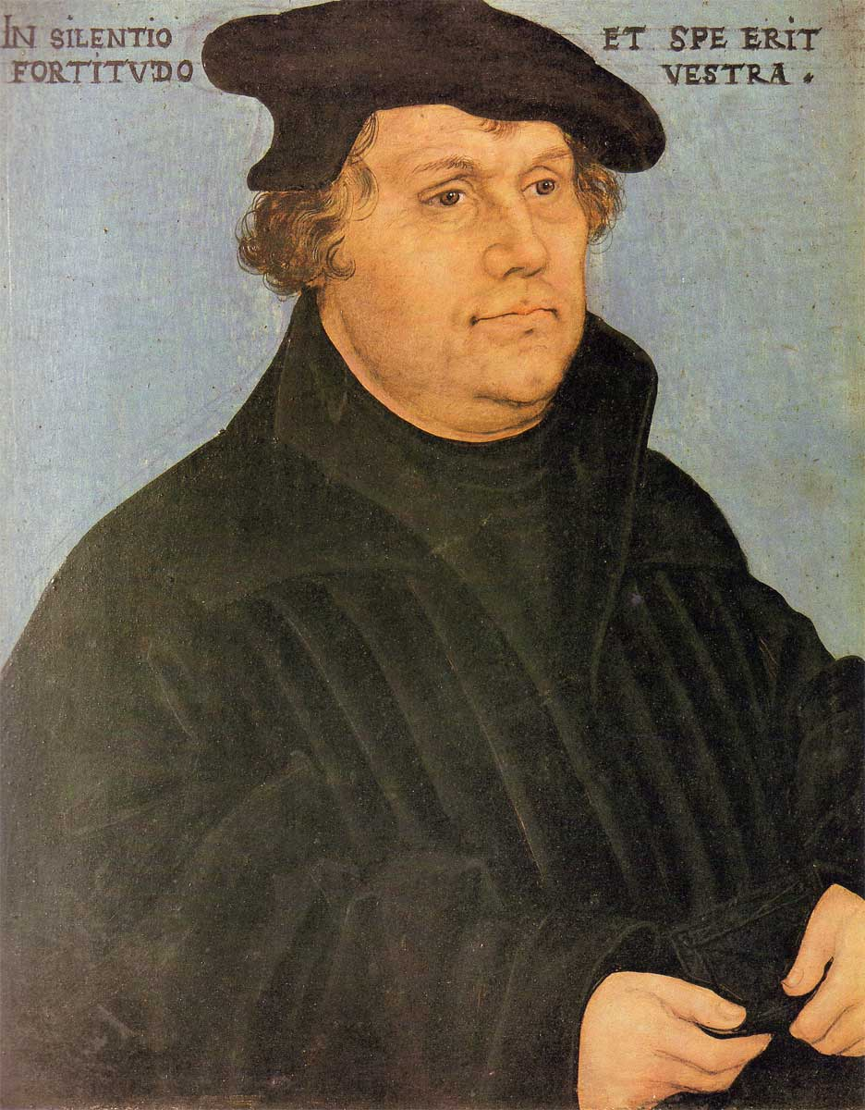
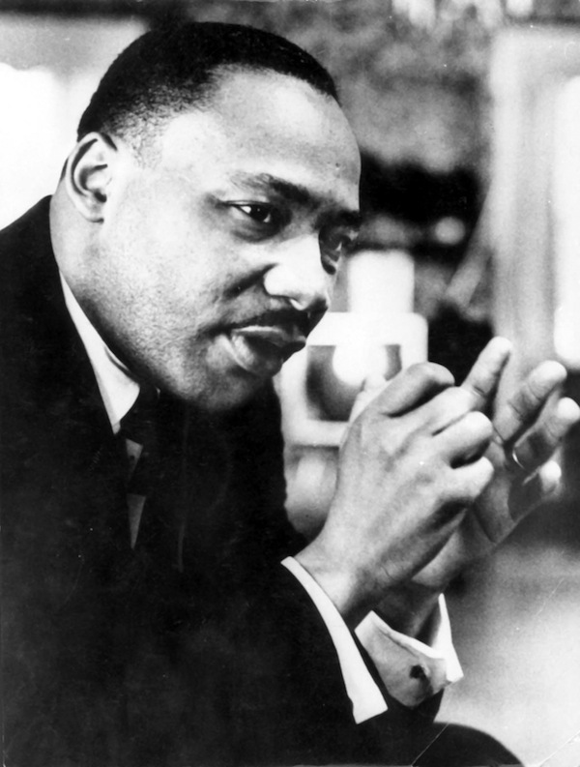
Enter Martin Luther

Slide 5
Luther
The 1517 Diet of Worms condemned Luther as a heretic and an outlaw.
  Luther is hidden by Prince Fredrick of Saxony
  In hiding, Luther translated the Bible into German & mass printed
  Bible was made available to the common people.
In 1525 German peasants revolt, inspired by Luther
  Violent
  Luther refused to support them
  German princes killed 70,000–100,000 peasants
Peace of Augsburg
  Each German prince can decide which religion their region will follow: Catholicism or Lutheranism
  First Christian alternative to Catholicism

Slide 6
Other Reformers
Solution to Martin Luther: Peace of Augsburg
  Each German prince can decide for their region: Catholicism or Lutheranism
  First Christian alternative to Catholicism in Western Europe
John Calvin
  Predestination—God has chosen who will gain salvation
  Set up community in Geneva, Switzerland
John Knox
  Calvinist in Scotland
  Rebellion that overthrew Catholic queen
  Begins Presbyterian Church
Anabaptists
  Baptize as adults
  anti-war, seen as radicals
  Influenced Amish, Quakers, Baptists

Slide 7
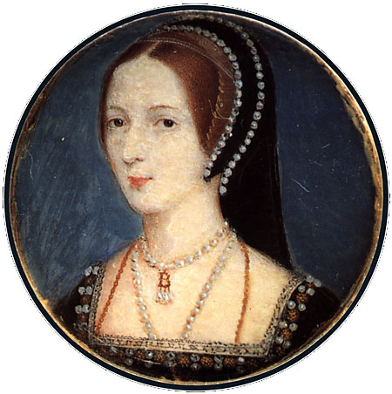
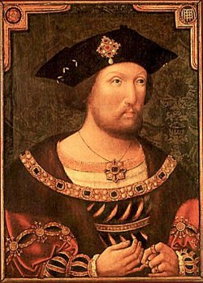
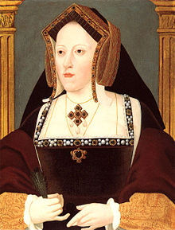
England Reformation
Henry VIII’s wife Katherine has had only one child—Mary—needs a son
  He falls for Anne Boleyn
  Pope refused divorce
  Breaks from Catholic church and declares self Head of the Church of England
  Marries Anne and she has Elizabeth

Slide 8
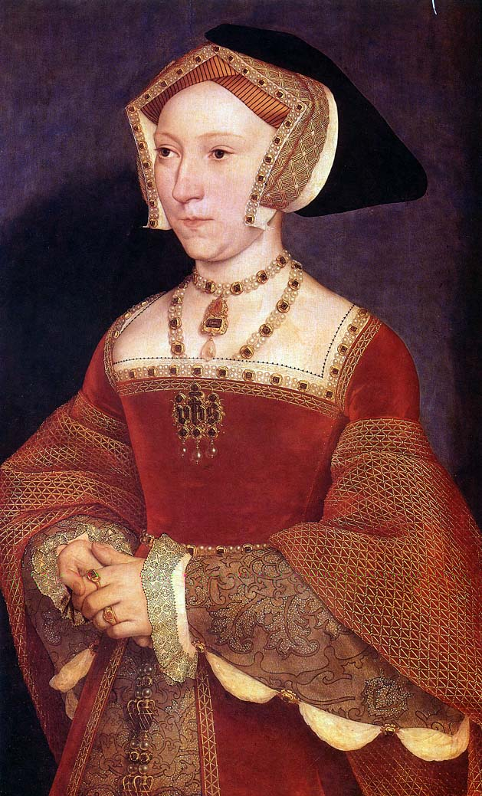
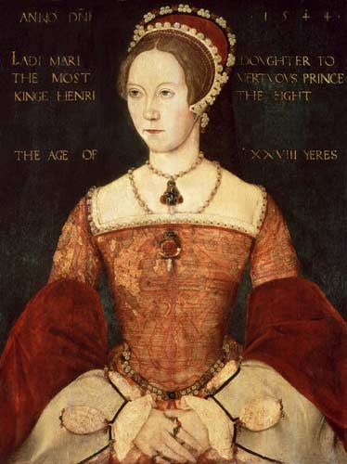
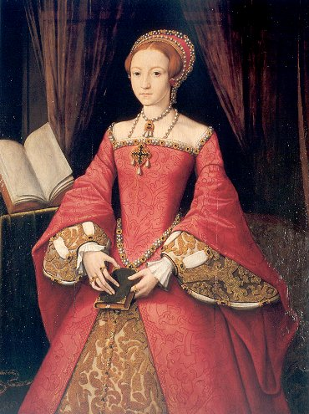
But what’s the problem?
Neither the Princess Elizabeth nor Princess Mary is an heir…
Henry tires of Anne & becomes suspicious—she is beheaded for treason when Elizabeth is 4
One Week Later: Henry marries Jane Seymour
  She gives birth to a son BUT dies in childbirth

Slide 9
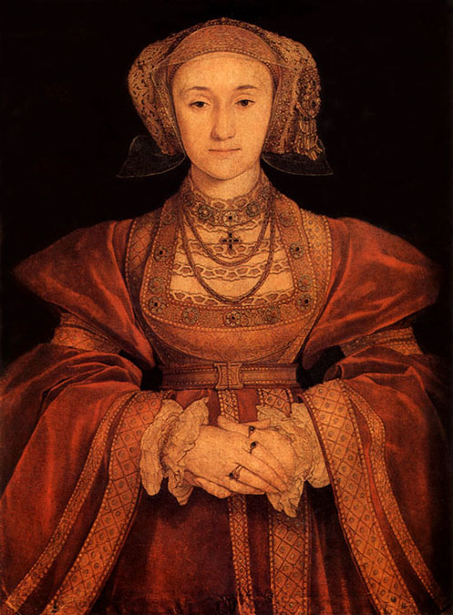
So What Does Henry Need?
A new wife!
Agrees to marry a German princess, Anne of Cleves, based on this portrait:
Unfortunately for Henry,
the artist was generous
to Anne
He divorces her

Slide 10
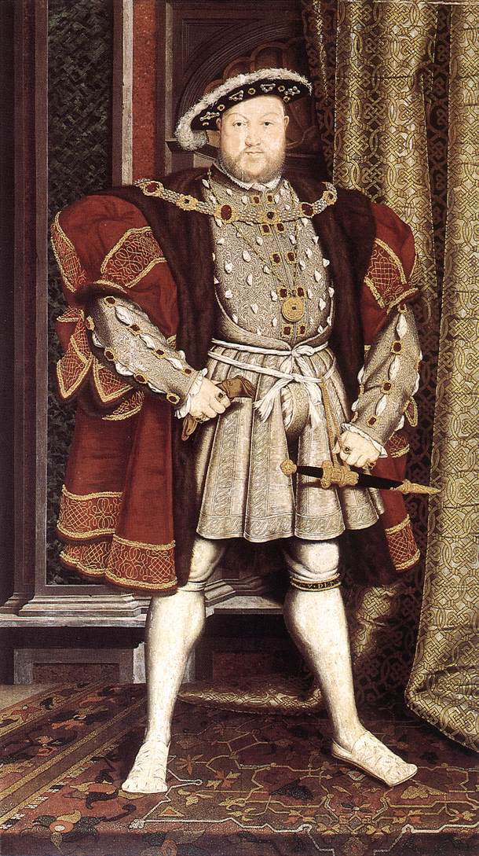
Keep this in Mind: Henry VIII is 49 & Looks A Bit Like This By This Point
Oh yeah,
And one of his legs was injured in a jousting accident and leaked puss, blood, and stench for the rest of his life
So overall, not nice…

Slide 11
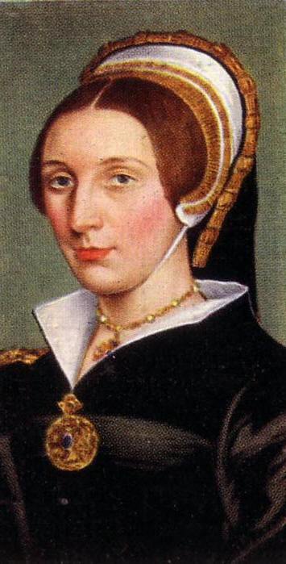
Then Henry Meets Katherine Howard
Katherine is beautiful, flirtatious…
and 15
Henry ’s Katherine
Katherine ’s Other Men
Henry finds out and she is beheaded
  On the block she admits her lover’s name…sucks to be that guy

Slide 12
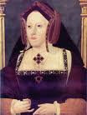
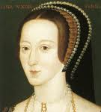
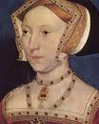
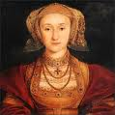

So Thus Far We Have
Divorced (Catherine of Aragon)
Beheaded (Anne Boleyn)
Died (Jane Seymour)
Divorced (Anne of Cleves)
Beheaded (Katherine Howard)
So next must be…

Slide 13
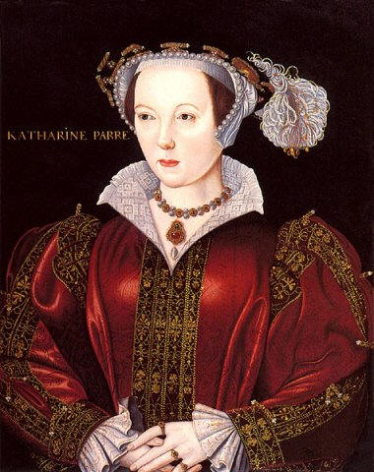
Survived!
Henry marries Catherine Parr
Serves as a nurse and friend until Henry’s death

