Slide 1
Ancient America

Slide 2
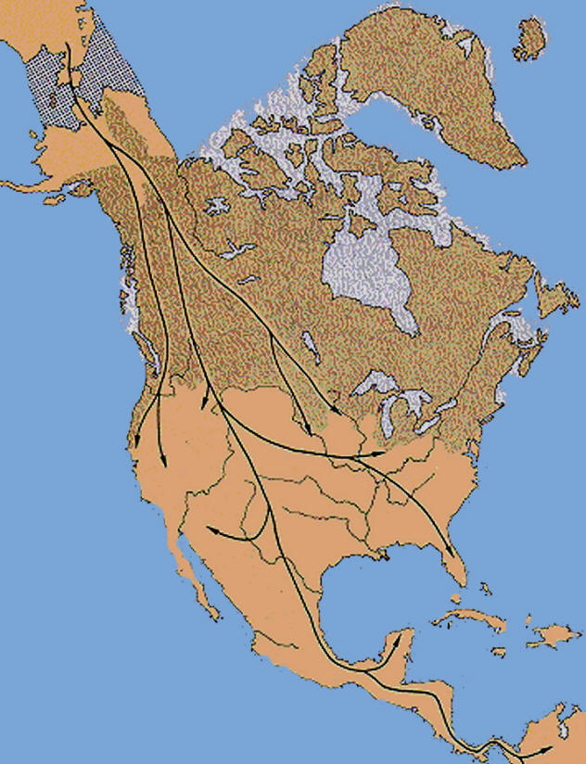
Migration to America
Bering Strait land bridge
  Nomadic people
  Following herds
Start to settle across N. & S. America
Notes:
Why do nomadic people travel?→ follow herds

Slide 3
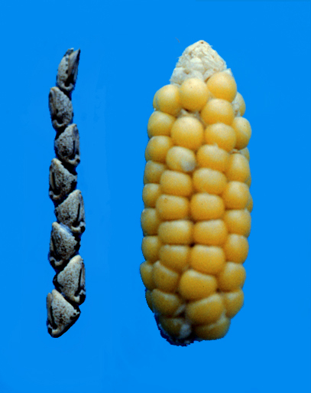
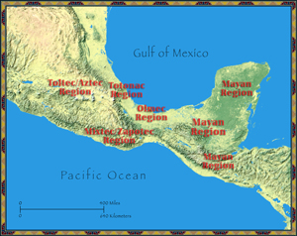
Mesoamerica
“Middle America”
Domesticate animals and plants (8500BC-2000BC)
  Maize, potatoes, tomatoes, beans
Populations boomed→ great cities
Notes:
What do you think “Meso” means? Where? Corn about actual size, ancient maize is very small

Slide 4
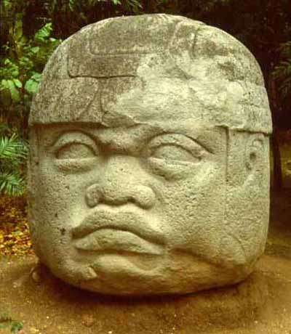
First Group: Olmecs
“Mother Culture”
Tropical forests along Gulf of Mexico, 1500 BC-400 BC
Trade influenced other cultures
Carved stone art, calendar, hieroglyphics
Notes:
What does mother culture mean? Actual descendents? “Inherited” culture (diffusion)

Slide 5
The Maya

Slide 6
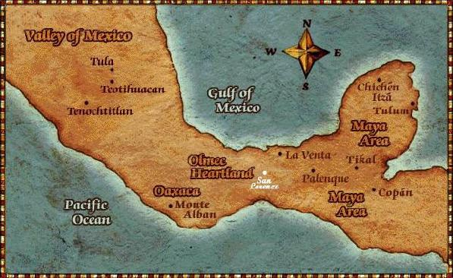
The Maya
300 BC to 900 AD→ The Classic Period
Yucatán Peninsula to Central America
Never an empire: city-states
  Ex: Tikal (most powerful)
  Each ruled by chief

Slide 7
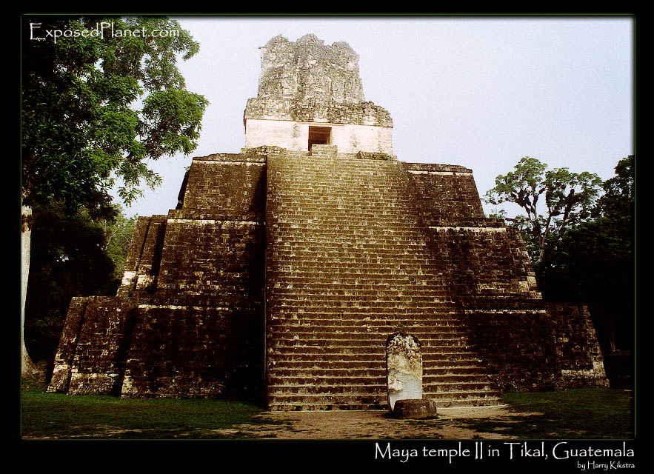
Society & Farming
Most are farmers
  Slash and burn to forests
  Raised fields on rivers
  Maize, beans, cotton, tropical flowers
  Food taxes
Polytheistic
  Central to life
  Priests very powerful
  Elaborate ceremonies

Slide 8
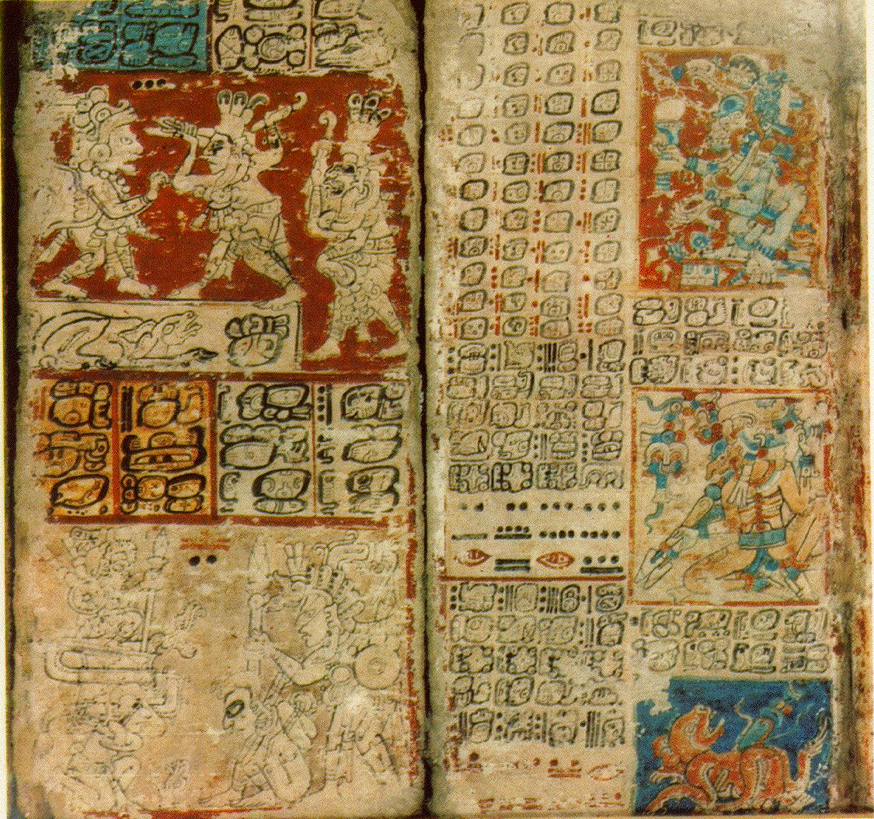
Achievements
Hieroglyphics
  Create codexes
  Many burned by Spanish
Astronomy
  Very accurate
  365 day solar calendar
Complex numbering system & value of zero

Slide 9
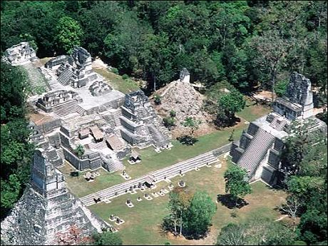
Decline
Abandon cities—why?
Theories:
  War
  Overpopulation
  Peasant revolt

Slide 10
The Aztecs

Slide 11
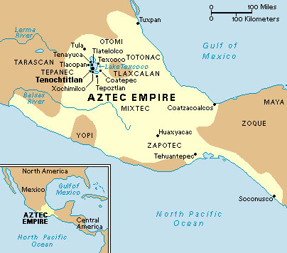
Aztecs
1200s-1500s
Called selves Mexica
  In modern day Mexico
Why?
  Wandered for 200 yrs looking for a sign
  An eagle with a serpent trapped in its mouth, atop a prickly cactus growing on a rock submerged in a lake.
  Finally found this off an island in Lake Texcoco
  Built their capital city, Tenochtitlán, large population

Slide 12
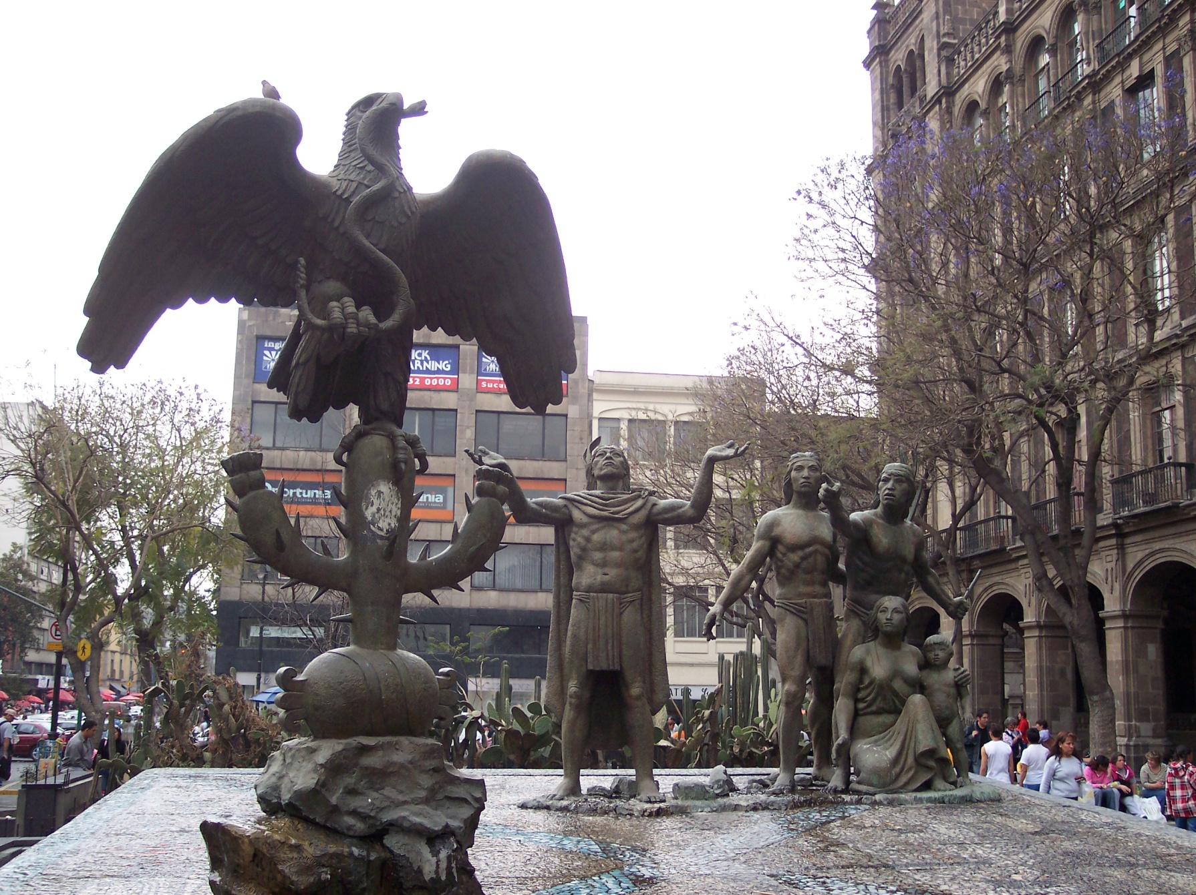
Statue in Mexico City

Slide 13
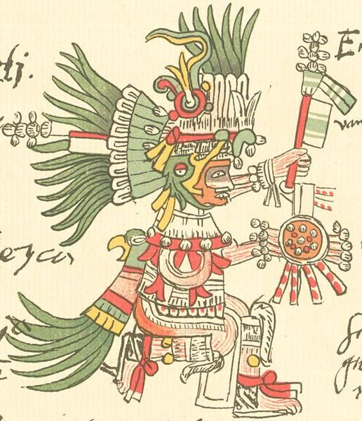
Government & Religion
Single empire
  Emperor meant to lead in war
  Called “The Great Speaker”
Polytheistic
  Huitzilopochtli – supreme god
  Quetzecotal – feathered-serpent god (god of earth and water)
  Priests very powerful
  Human sacrifices
    Beleived the gods sacrificed themselves, so should man

Slide 14
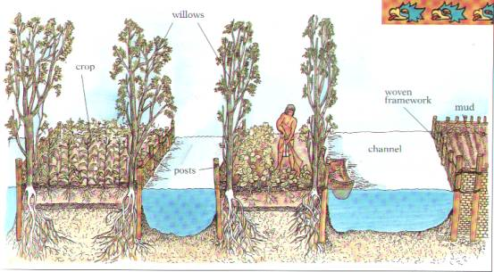
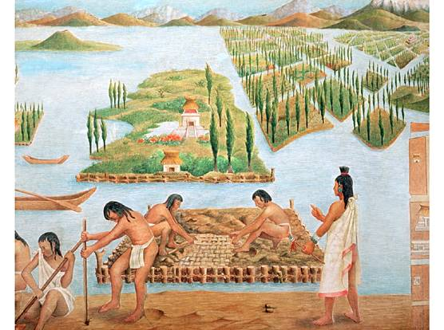
Farming
Chinampas
  “floating garden”
  Artificial islands

Slide 15
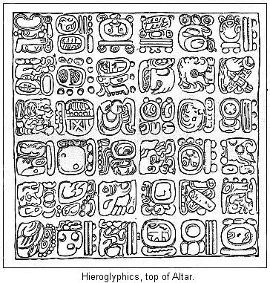
Science
Believed illness caused by the gods
  Herbs and meds
  Set broken bones/fill cavities
  Steam baths
Accurate calendar
Hieroglyphics

Slide 16
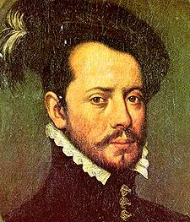
Decline
Spanish invaders in 1500s (Conquistadors)
Hernado Cortes

Slide 17
The Incas

Slide 18
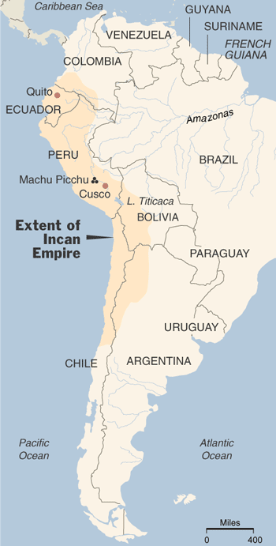
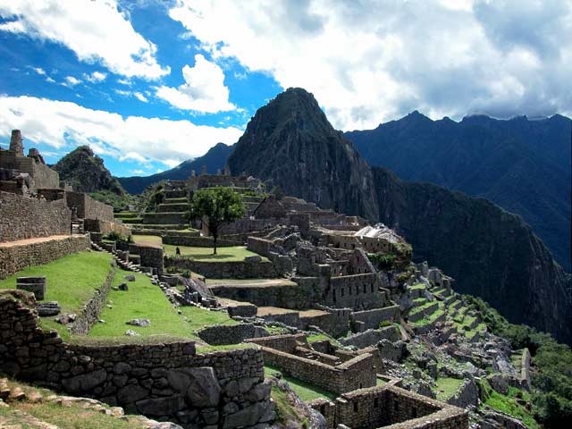
The Inca
1100s-1500s
Ecuador to Chile
Andes Mountains
  Hard to farm
Capitol City: Cuzco
  Machu Picchu

Slide 19
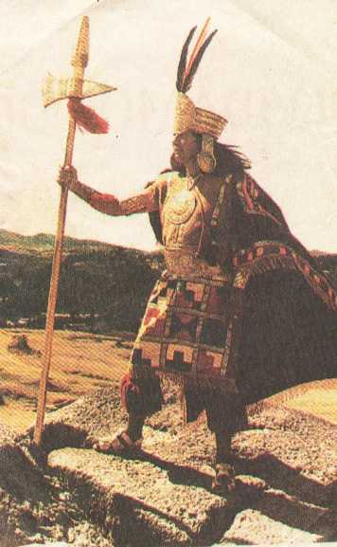
Government
Empire
  God-King called “Sapa Inca”
  Owned all lands, herds, mines, & people
  Coya—queen, in charge of religious duties
Efficient government with trained officials

Slide 20
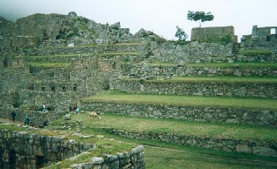
Religion & Farming
Polytheistic—linked to nature
  Monthly rituals/offerings
  Priests powerful
Farming
  Step terraces
  Potatoes and maize

Slide 21
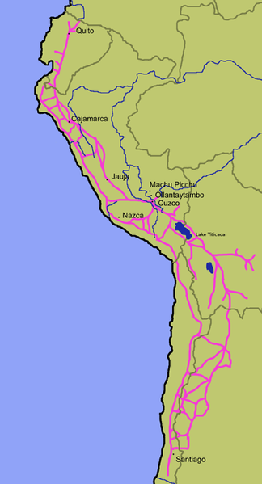
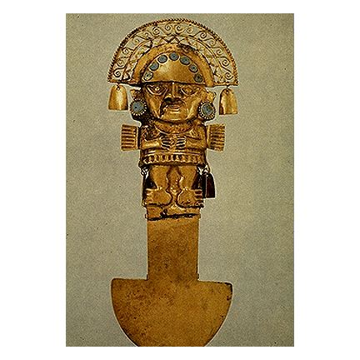
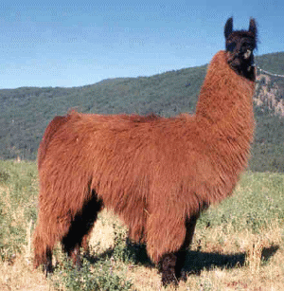
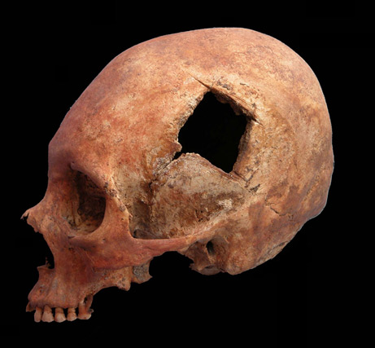
Achievements
Unified empire with road networks
  14,000 miles through mts & deserts
  Llamas
Skilled metalwork & weavers
  Wool from llamas
  Copper, tin, bronze
Surgery on skull, antiseptics, & mummification

Slide 22
Decline
Pizarro invades and overthrows emperor

