Slide 1
Imperialism
National Power
Strong v. Weak
Domination:
Culture
Politics
Economics

Slide 2
Reasons?
New resources
Ports around world
Missionaries
“Survival of the fittest” “White Man’s Burden
Why Western Europe?
Industry
Technology

Slide 3
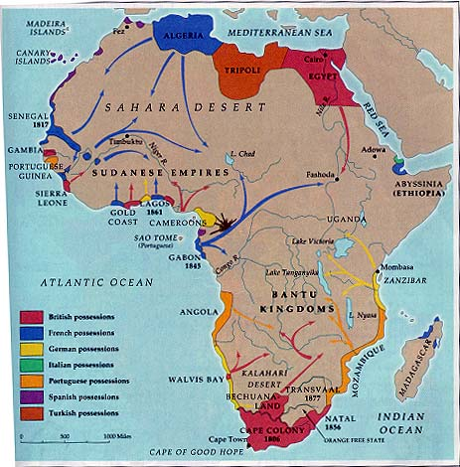
African Imperialism: 1850

Slide 4
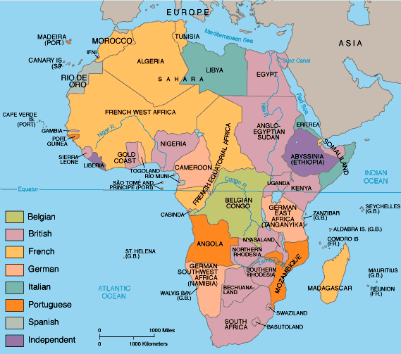
African Imperialism: by 1914

Slide 5
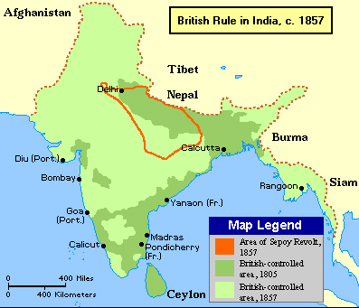
Why India?

Slide 6
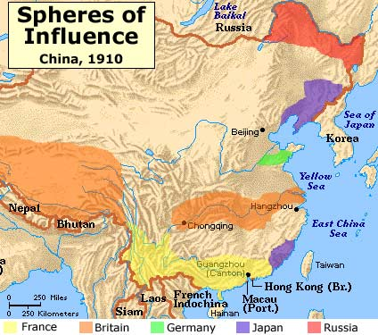
Why China?

Slide 7
Imperial Countries: focus on the effects
Imperial Country | Region Colonized
Belgium | Congo
France | West and North Africa/China
Germany | Indonesia/ SW & East Africa
Great Britain | India/Middle East/Australia/China/Africa
Italy | North/East Africa
Netherlands | Indonesia
Portugal | Southern Africa
Russia | Black Sea/Mongolia
Spain | North Africa
United States | Philippines/ Hawaii

Slide 8
Excerpt from the “The White Man’s Burden”
“Take up the White Man's burden- Send forth the best ye breed-- Go bind your sons to exile To serve your captives' need; To wait in heavy harness, On fluttered folk and wild-- Your new-caught, sullen peoples, Half-devil and half-child…”
Sullen=grim, gloomy

Slide 9
Imperialism Political Cartoons
What are the major images that you see? Who or what do you think they represent?
Is this a pro or anti Imperialist cartoon? Give details from the cartoon to show how this is true.
What do you think is the topic or message of this political cartoon?

Slide 10
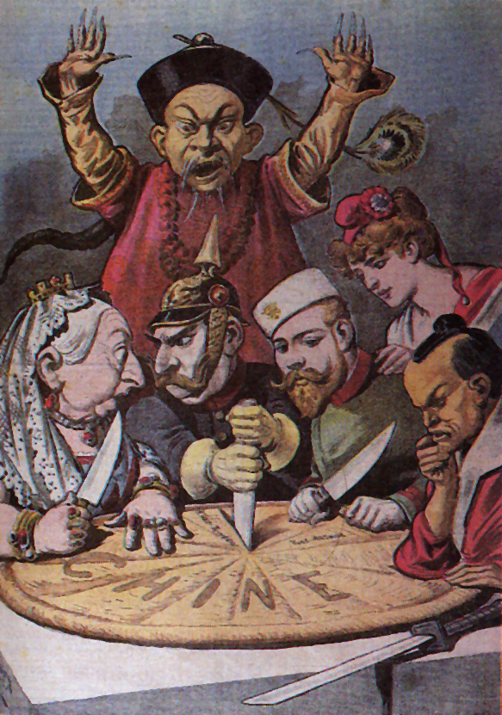

Slide 11
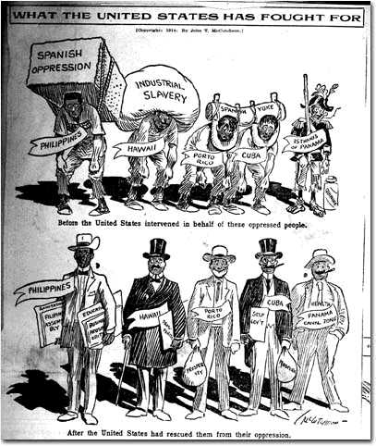

Slide 12
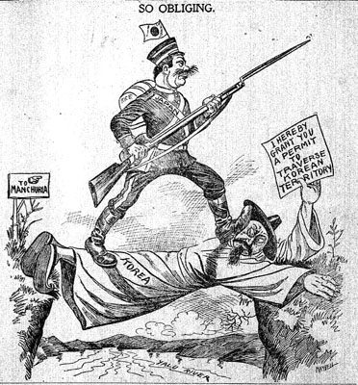

Slide 13
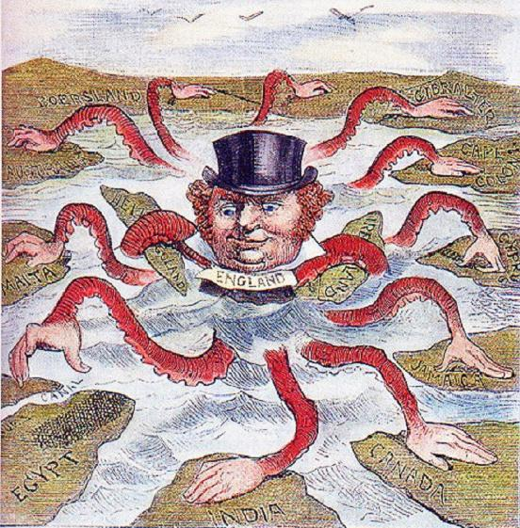

Slide 14
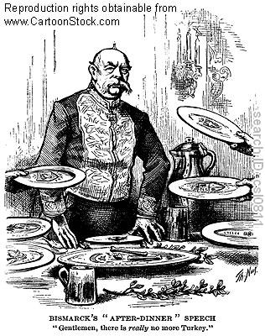

Slide 15
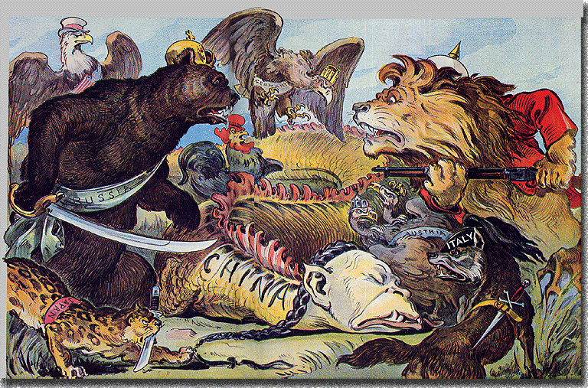

Slide 16
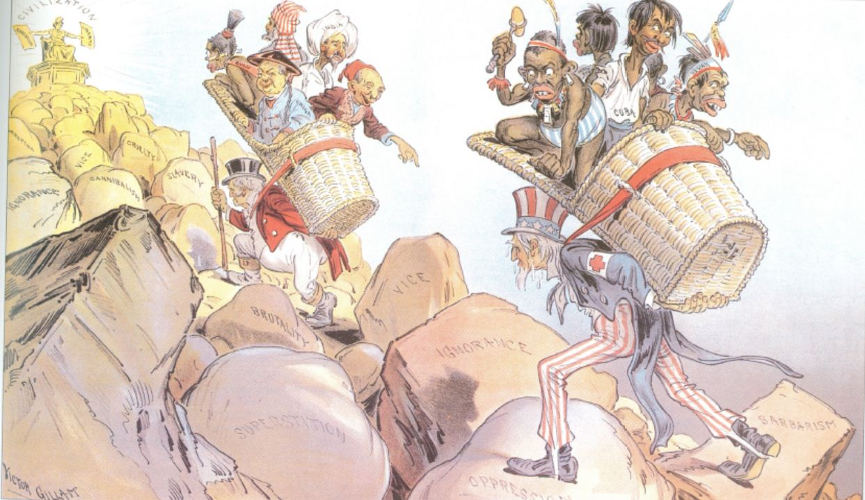

Slide 17
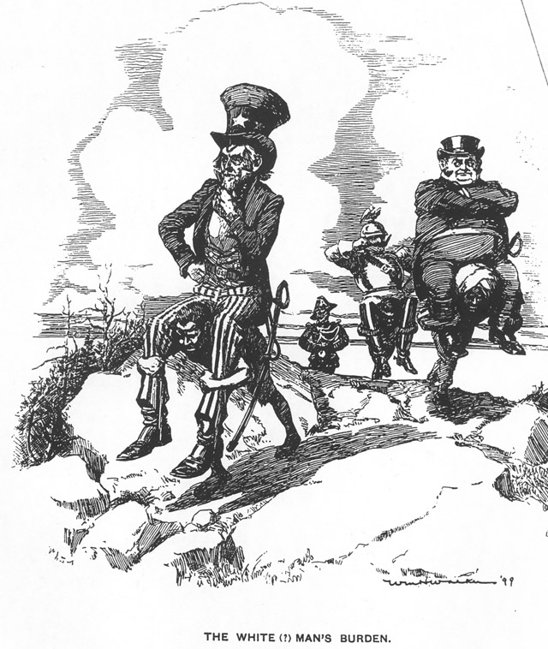
bb

