Slide 1
Journal
Read this poem written by a German pastor during WWII. What does he mean? What is his message for future generations?
First they came for the Socialists, and I did not speak out— Because I was not a Socialist.
Then they came for the Trade Unionists, and I did not speak out— Because I was not a Trade Unionist.
Then they came for the Jews, and I did not speak out— Because I was not a Jew.
Then they came for me—and there was no one left to speak for me.

Slide 2
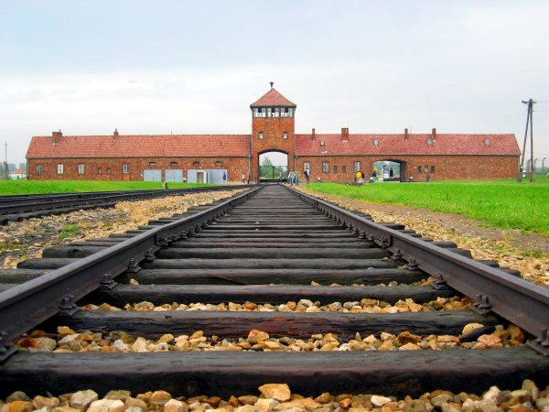
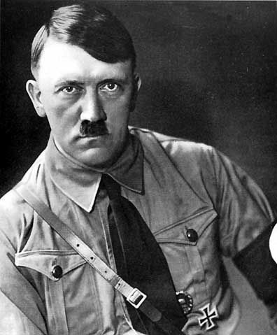
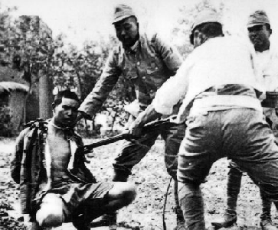
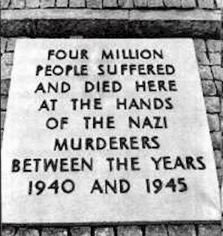
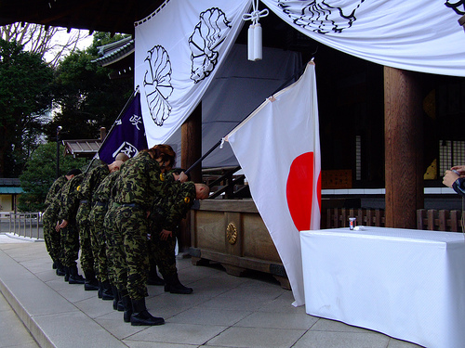
Human Rights Abuses in WWII

Slide 3
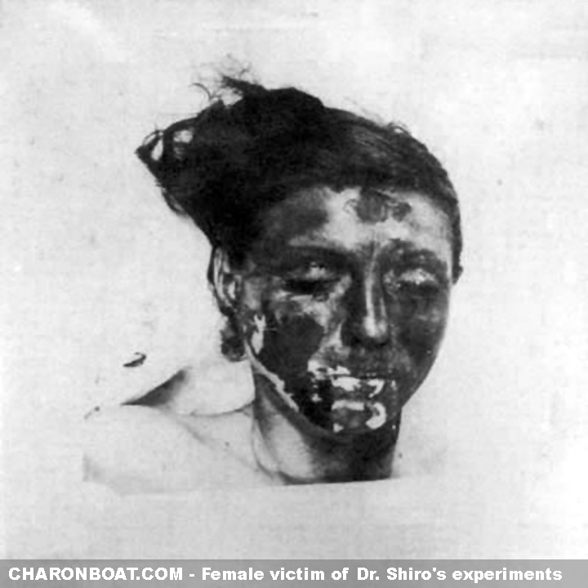
Unit 731
Over 580,000 were killed by germ warfare and human experiments by the Japanese army’s medical division in China.
As the Japanese army moved through China, its medical unit – Unit 731 - dispatched its own subunits throughout the country to conduct experiments on Chinese civilians and soldiers.
To determine the treatment of frostbite, prisoners were taken outside in freezing weather and left with exposed arms, periodically drenched with water until frozen solid. The arm was later amputated; the doctor would repeat the process on the victim's upper arm to the shoulder. After both arms were gone, the doctors moved on to the legs until only a head and torso remained. The victim was then used for plague and pathogens experiments.

Slide 4
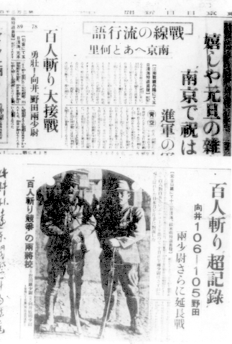
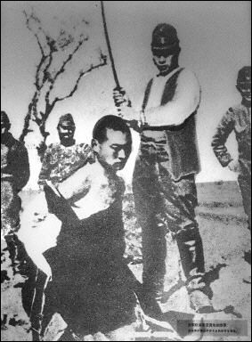
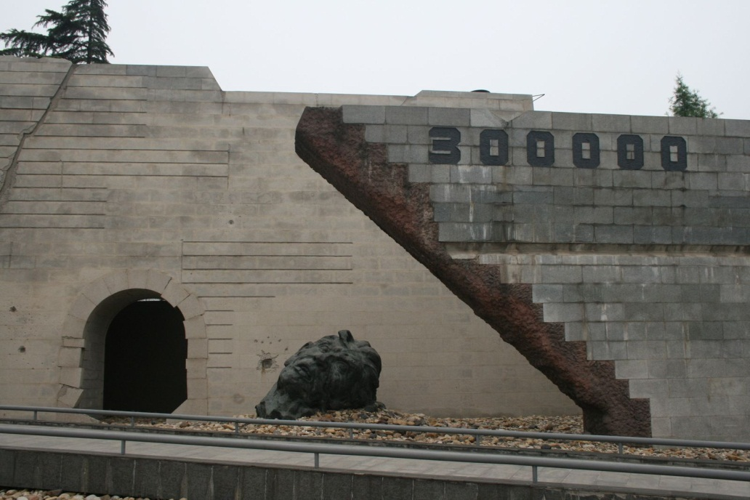
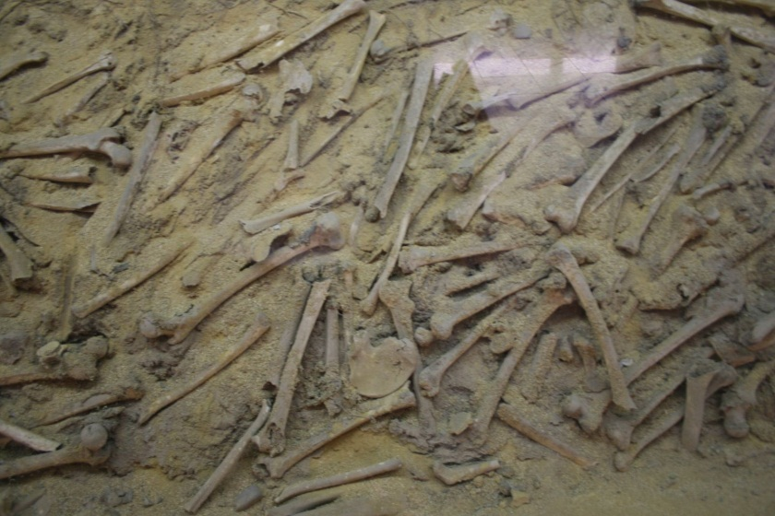
MASSACRE OF NANJING Between Dec 12, 1937 and January of 1938 300,000 Chinese civilians in Nanjing were killed

Slide 5
Nanjing Massacre
After the fall of Shanghai, the Japanese moved on to the Chinese capital at Nanjing. Enroute to Nanjing, 2 Japanese officers held a contest to see who could behead 100 Chinese and the contest was covered by Japanese newspapers.
On December 13, 1937 the Japanese captured Nanjing. Over the next 6 weeks the Japanese army ran a campaign of terror; killing, maiming, mutilating, raping the population, many women and children, who had not fled the city. Chinese women and girls were forced to be “comfort girls” for Japanese soldiers. Either the Japanese prince in charge of the army in Nanjing or one of his subordinates gave the order to “kill all captives”. Many of the bodies were buried in mass graves or deposited in the Yangtze River.
Footage of the Massacre and its victims by American John Magee who was in the “Safety Zone” and who smuggled the film reels out of China to the U.S.:
http://www.youtube.com/watch?v=YeIxDezImGM&feature=related
In more recent times, Japanese soldiers who participated in the massacres at Nanjing have confessed about what happened.

Slide 6
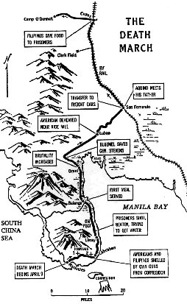
Bataan Death March, 1942
American and Filipino forces surrendered to the Japanese on April 9. The Japanese immediately began to march some 76,000 prisoners northward into captivity along a 60-mile route
Japanese butchery, disease, exposure to the blazing sun, lack of food, and lack of water took the lives of approximately 5,200 Americans along the way.
Many were bayoneted, shot, beheaded or just left to die on the side of the road. "A Japanese soldier took my canteen, gave the water to a horse, and threw the canteen away," reported one escapee. "The stronger were not permitted to help the weaker. We then would hear shots behind us." The Japanese forced the prisoners to sit for hours in the hot sun without water. "Many of us went crazy and several died.“

Slide 7
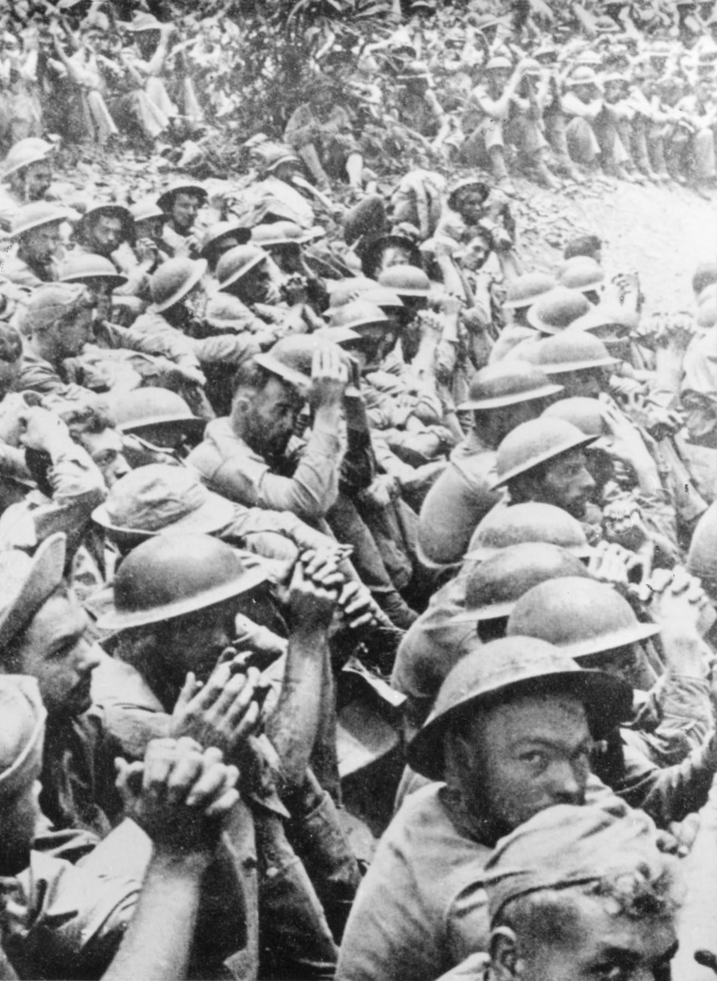
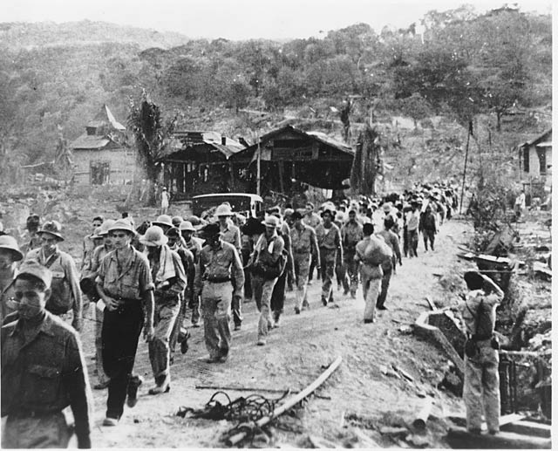
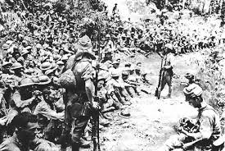
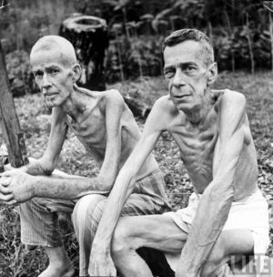

Slide 8
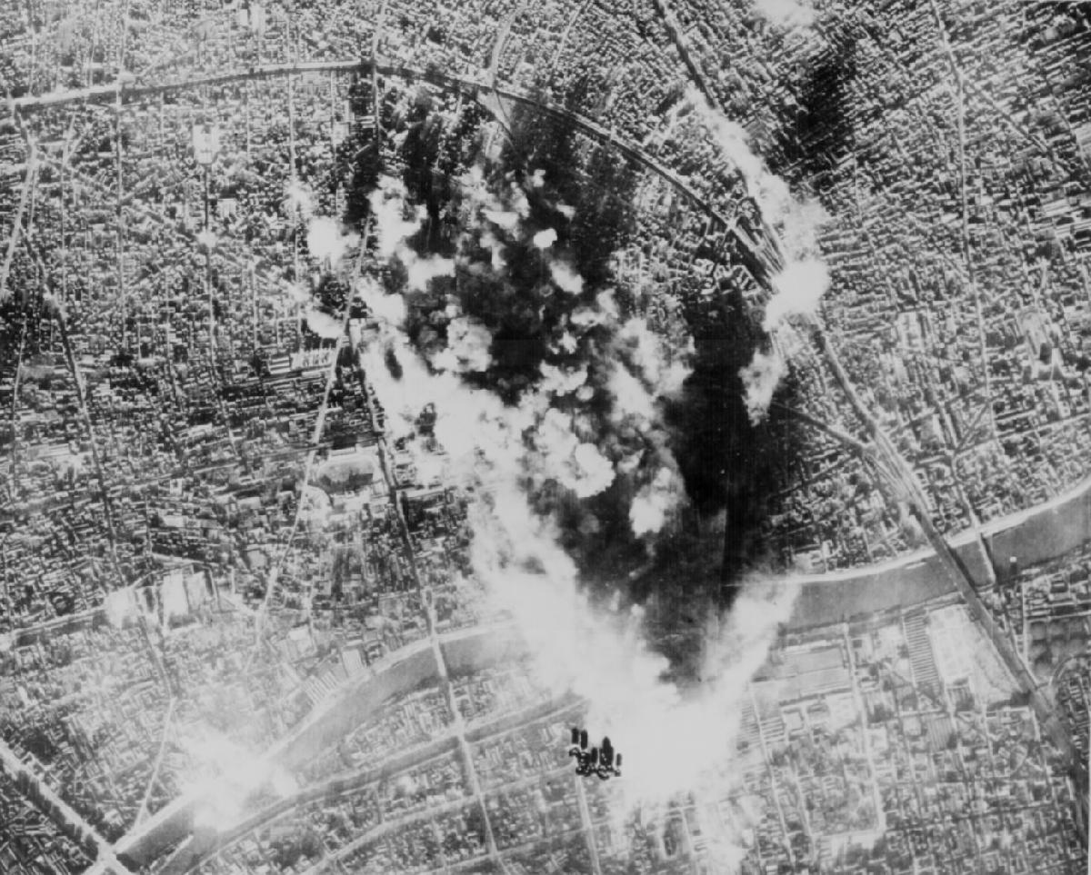
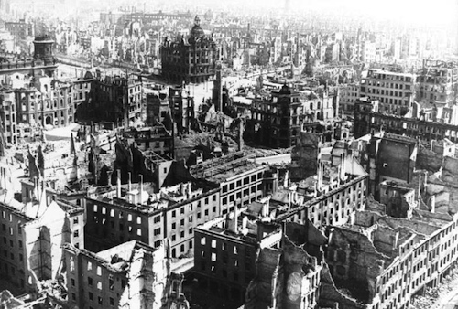
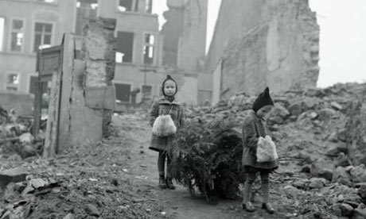
“Strategic Bombing”
Bombing of cities to attempt to force a surrender

Slide 9
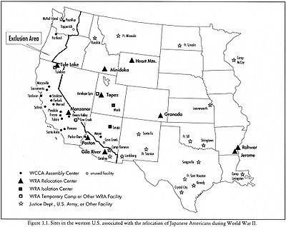
Japanese Internment
After bombing of Pearl Harbor, President Roosevelt signed Executive Order 9066
Japanese immigrants and Japanese Americans living on the West Coast were forced to move to internment camps

Slide 10
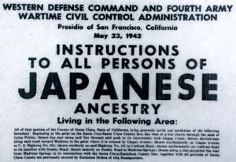

Slide 11
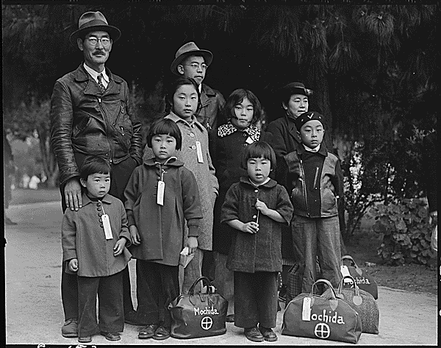
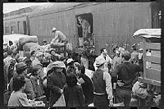
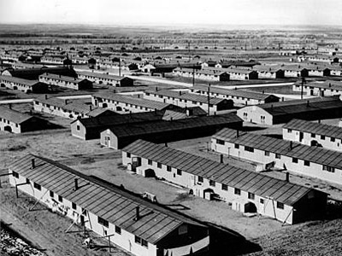
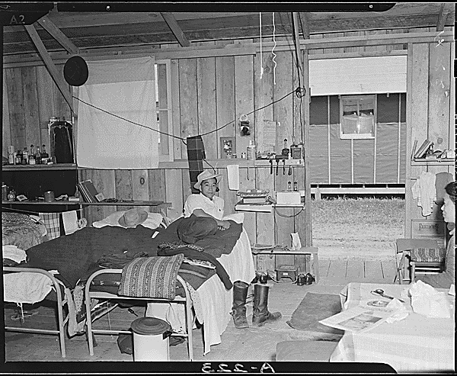

Slide 12
Dropping of the Atomic Bombs
McArthur was planning an invasion of Japanese mainland. Estimated 1,000,000 casualties expected.
Americans had been firebombing cities, but the Japanese government had ordered their civilians not to surrender to Americans
Manhattan Project: secret planning and research on the atomic bombs
Truman makes the call to drop the bombs in order to force an end to the war.

Slide 13
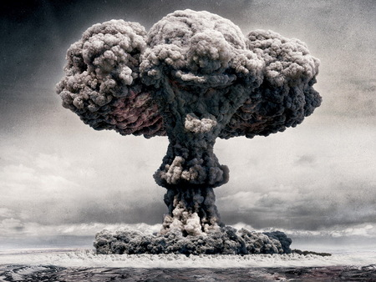
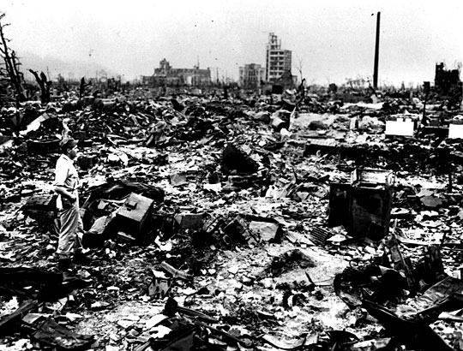
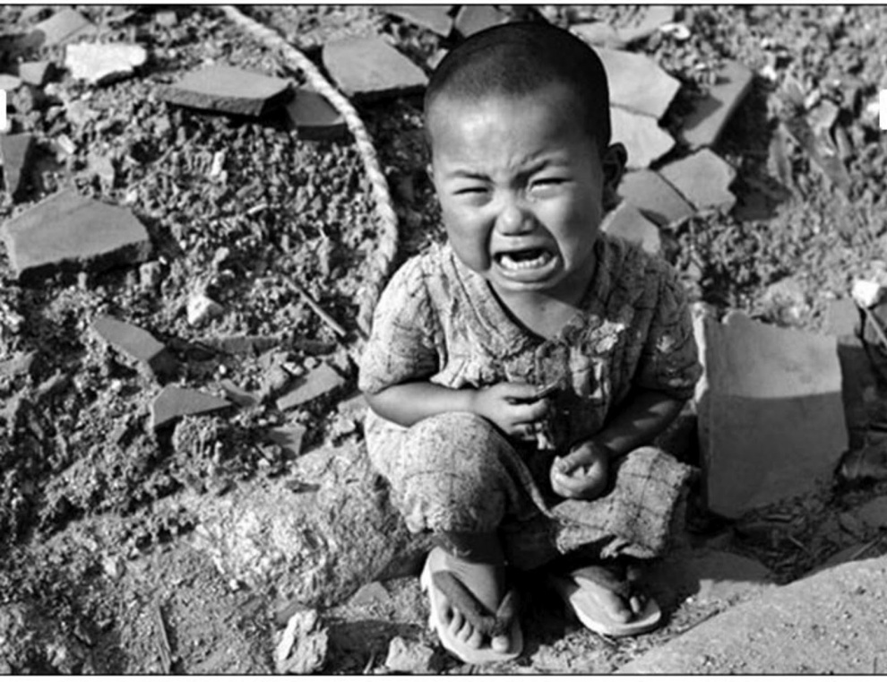
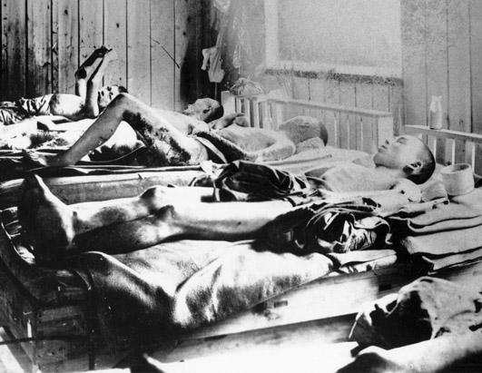

Slide 14
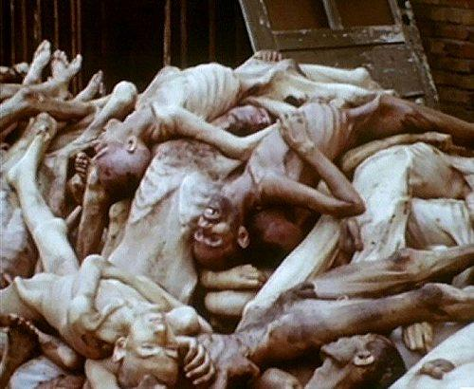
Final Solution

Slide 15
Life in Nazi Germany – Nuremberg Laws
1933 – Hitler becomes dictator in Germany after the Reichstag is burned down.
September 1935 -German government created a set of laws that divided Germany into 2 groups – those considered “acceptable” and everyone else.
Marriage between Jews and Germans prohibited
Intercourse between Jews and Germans is forbidden
Female Germans under age of 45 were not allowed to be employed by Jews
Jews cannot fly German flag
Jews were removed from jobs such as doctors, lawyers, teachers, news reporting
Punishment – hard labour and/or imprisonment
Nov. 1935 – Laws extended to many non-Jewish groups in Germany including Roma and non-whites living in Germany
.

Slide 16
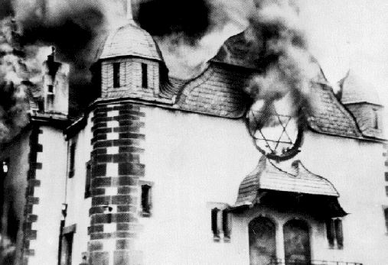
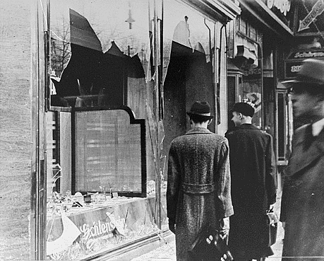
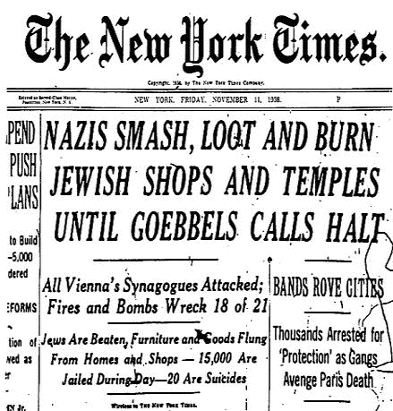
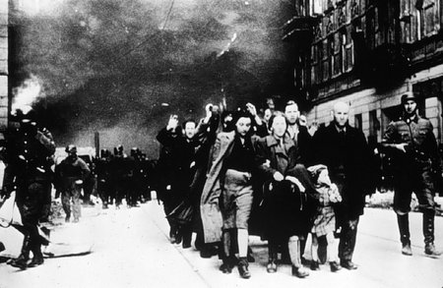
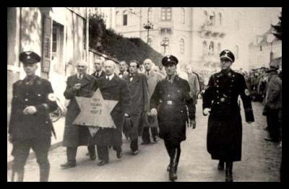
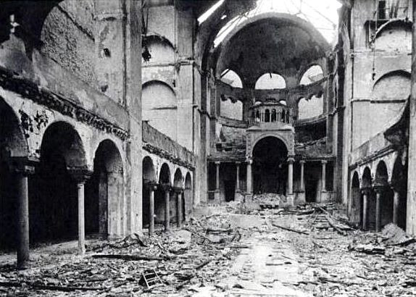
Kristallnacht
70th anniversary of Kristallnacht: http://news.bbc.co.uk/2/hi/europe/7719032.stm

Slide 17
Implementing the Final Solution
Wannssee Conference (1942): The German secret police (SS) discuss a plan to eliminate Jews from Germany as directed by Nazi Leader Hermann Goring. Hitler calls it the “Final Solution”.
It is implemented in “Operation Reinhard” - the establishment of extermination camps in Poland.

Slide 18
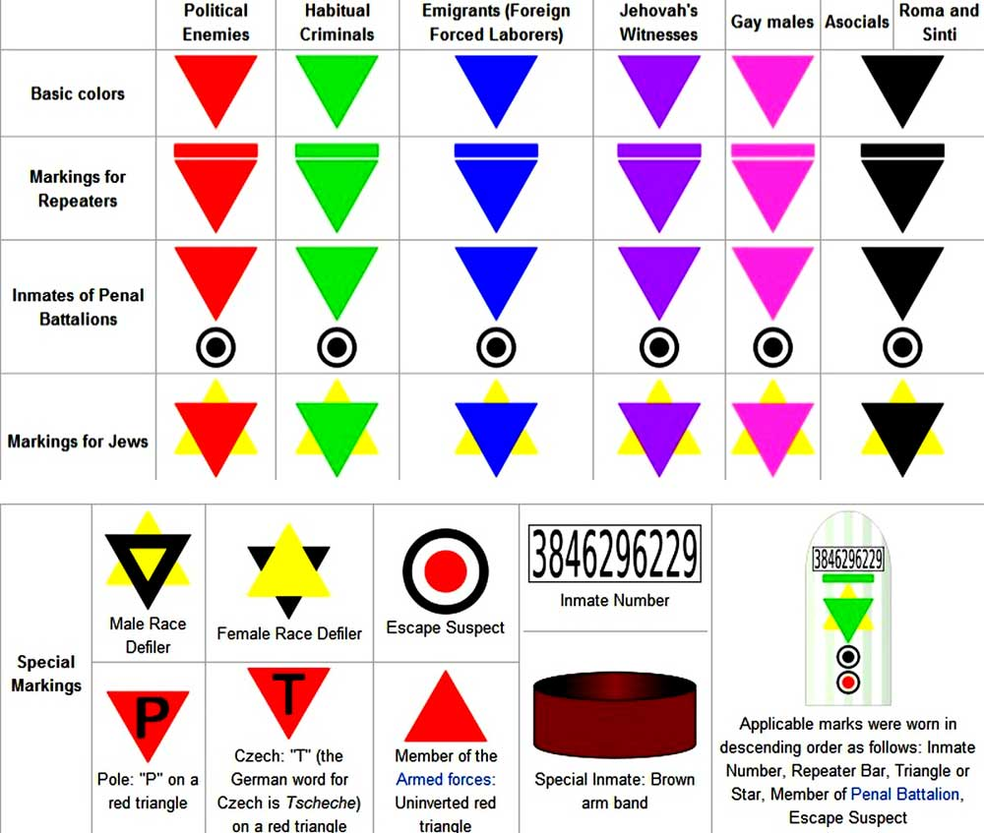

Slide 19
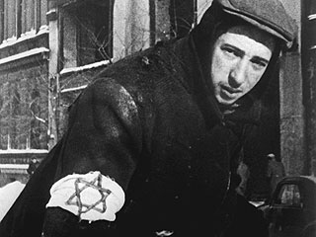
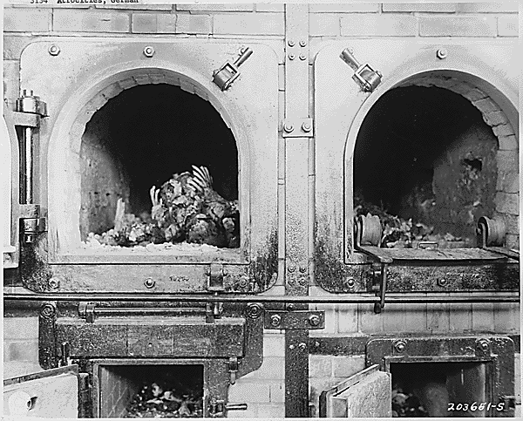
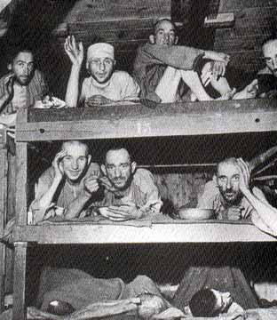
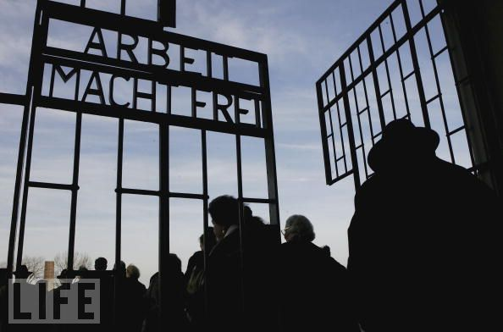
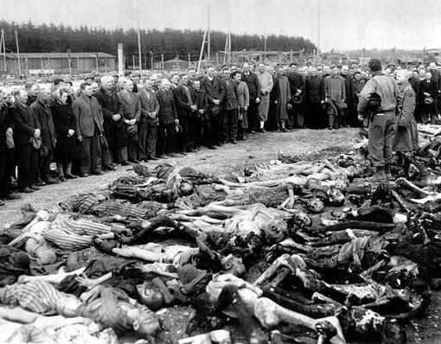

Slide 20
Posen, Germany (October 4, 1943): Heinrich Himmler – Head of the SS delivers a speech inlcuding:
One basic principle must be the absolute rule for the SS men : We must be honest, decent, loyal and comradely to members of our own blood and to nobody else. What happens to a Russian, to a Czech, does not interest me in the slightest. What other nations can offer in the way of good blood of our type, we will take, if necessary, by kidnapping their children and raising them here with us. Whether nations live in prosperity or starve to death interests me only so far as we need them as slaves for our culture; otherwise, it is of no interest to me. Whether 10,000 Russian females fall down from exhaustion while digging an antitank ditch interests me only insofar as the anti-tank ditch for Germany is finished.

Slide 21
Himmler then continues:
I am now referring to the evacuation of the Jews, the extermination of the Jewish people. It's one of those things that is easily said: 'The Jewish people are being exterminated', says every party member, 'this is very obvious, it's in our program, elimination of the Jews, extermination, we're doing it, hah, a small matter.' [...] But of all those who talk this way, none had observed it, none had endured it. Most of you here know what it means when 100 corpses lie next to each other, when 500 lie there or when 1,000 are lined up. To have endured this and at the same time to have remained a decent person - with exceptions due to human weaknesses - had made us tough. This is a page of glory never mentioned and never to be mentioned. [...] We have the moral right, we had the duty to our people to do it, to kill this people who wanted to kill us.

Slide 22
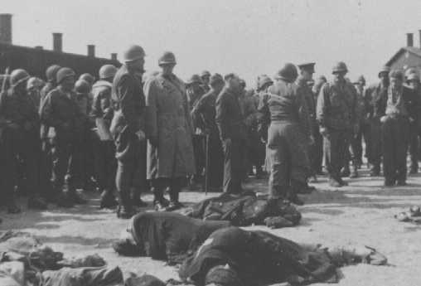
Liberation of the Camps
When WWII ends, the Americans, British, and Soviets made up the largest groups of soldiers who entered the camps and freed their prisoners. On April 12, 1944 US General Eisenhower toured the recently captured Buchenwald camp. He then gave orders for every citizen of the town nearest Buchenwald to personally tour the camp. Afterwards the mayor of the town and his wife hung themselves when they saw what had happened in their midst. Gen. Eisenhower ordered all non-military personnel to tour and record all they saw in the camps. http://archive.org/details/gov.fdr.348
Gen. Eisenhower (with Gen Patton) “I made the visit deliberately, in order to be in a position to give first-hand evidence of these things if ever, in the future, there develops a tendency to charge these allegations merely to ‘propaganda.’”.

Slide 23
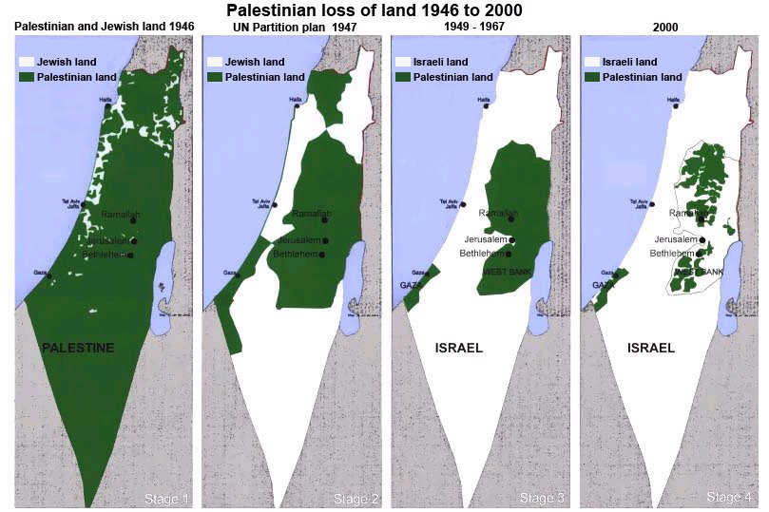
Effects of Human Rights Violations in WWII
To give European Jews a safe place to live, the state of Israel was created on May 14, 1948.
It was created out of the former territory of Palestine which was controlled by Great Britain.
One of the results of this has been a conflict between the Arab Palestinians who were the majority of the population before 1948 and the Jewish population who hold most of the political power in the country.

Slide 24
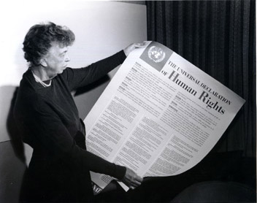
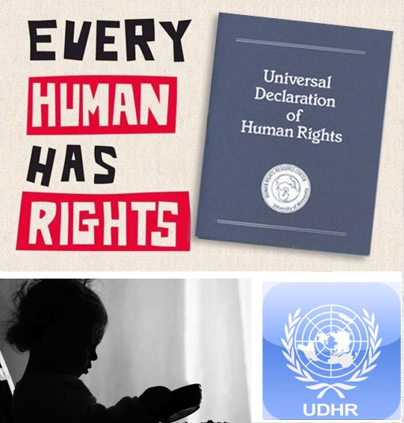
Effects of Human Rights Violations in WWII
To prevent future wars like World War Two, the United Nations was created with the hope of solving some of the problems that the League of Nations had.
On Dec. 10, 1948, the United Nations also created the “Universal Declaration of Human Rights” which tells countries what they have to allow or give their citizens. It is intended to prevent things like the Holocaust.
It was written by a Canadian lawyer, John Humphries.

