Slide 1
Revival of Learning & Culture of the Middle Ages The High Middle Ages

Slide 2
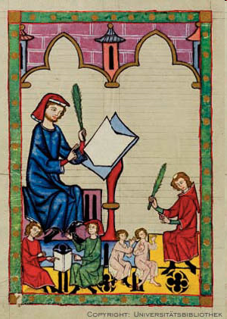
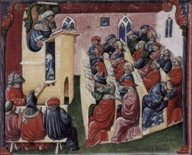
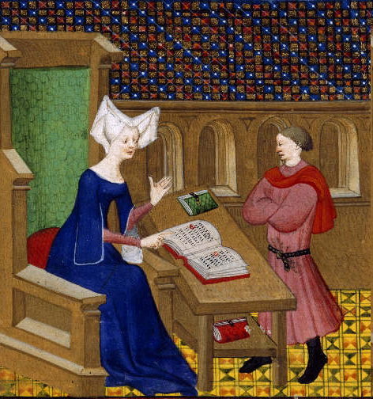
Universities
Need better educated priests
Latin, Liberal Arts
Women didn’t attend
Christine de Pisan: The City of Ladies

Slide 3
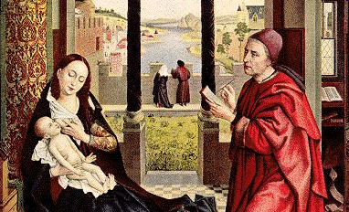
Scholasticism
Christianity could be proved with logical argument
Influenced by Aristotle
Thomas Aquinas: Summa Theologicas
Combined Greek and Christian thought
Debated issues of time

Slide 4
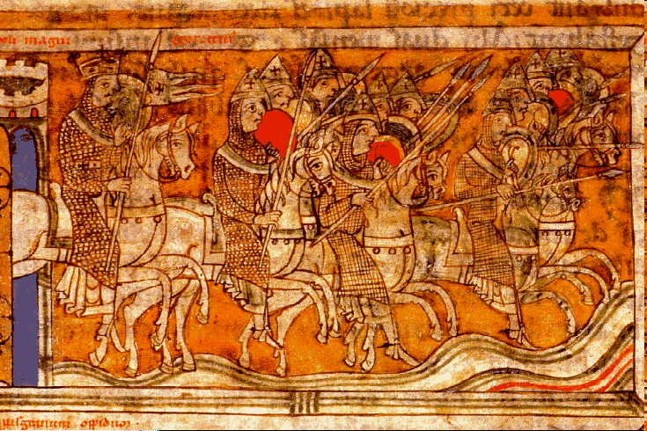
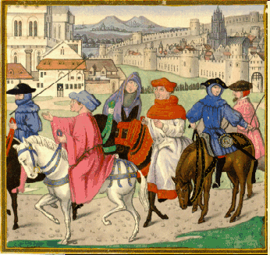
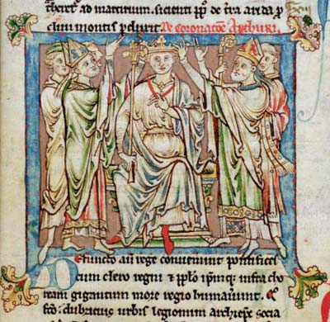
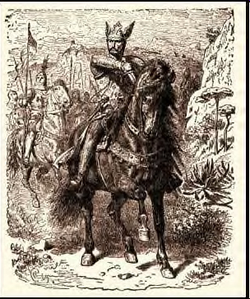
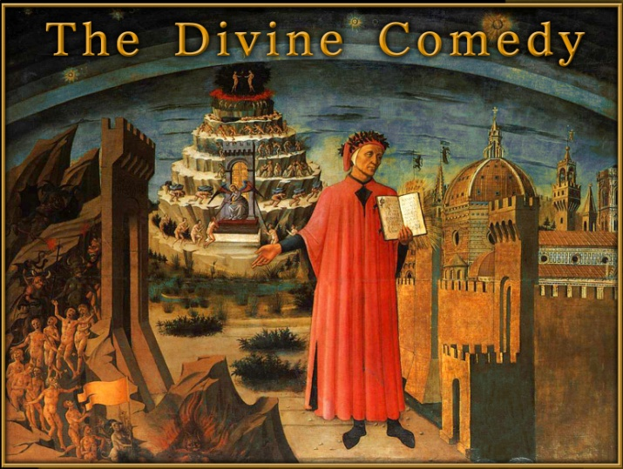
Literature
Writing in Vernacular:
everyday language
Hero Epic-
Song of Roland (Charlemagne)
El Cid, Spanish Lord
Romances, King Arthur
Chaucer: The Canterbury Tales, Shows Medieval life
Dante: The Divine Comedy, Italian

Slide 5
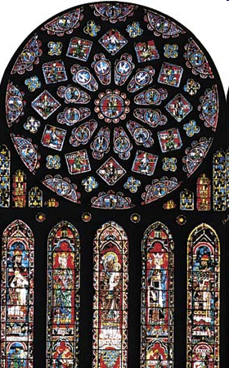
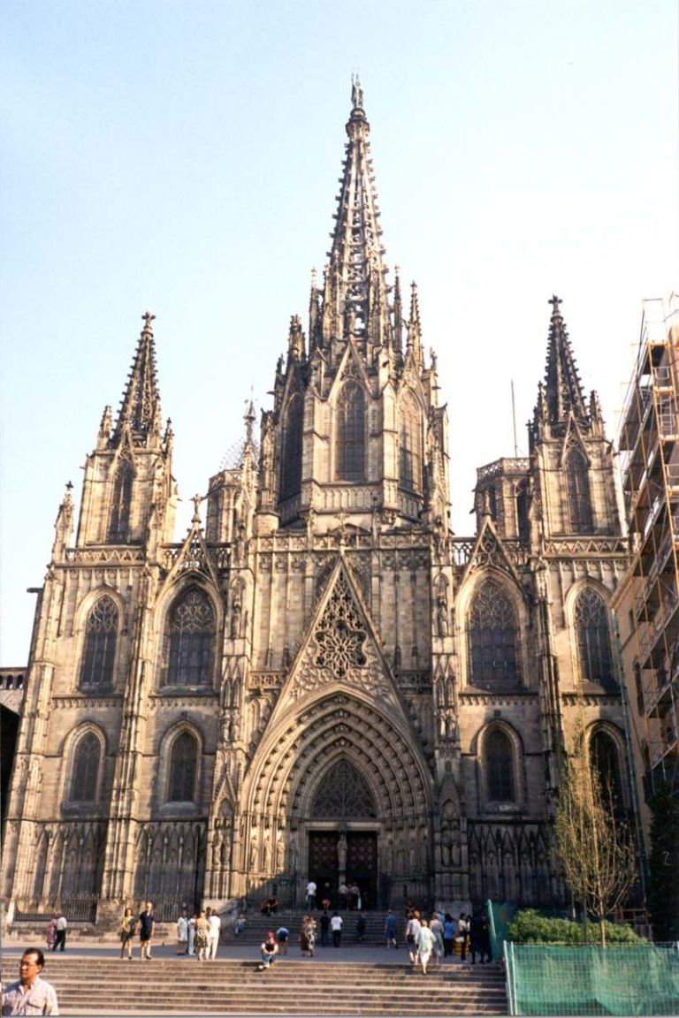
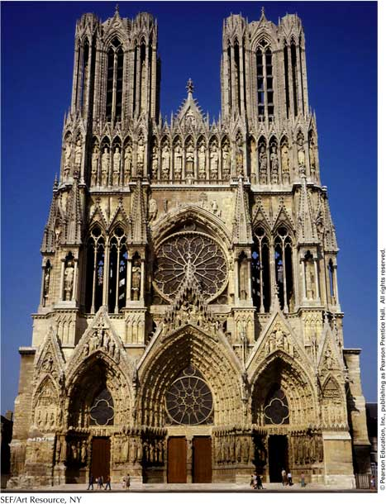
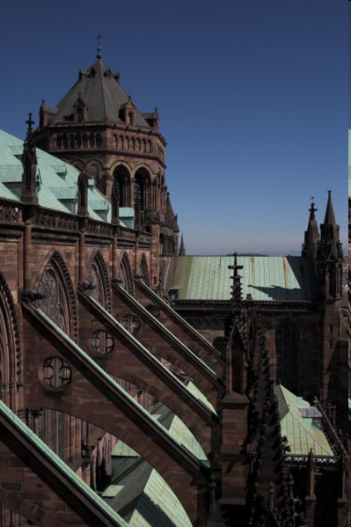
Architecture
Gothic Style:
Tall spires & Tall Windows
Flying Buttress
Stained Glass: Told Bible stories, purpose to educate
Reaching towards Heaven, “City of God”
Romanesque

Slide 6
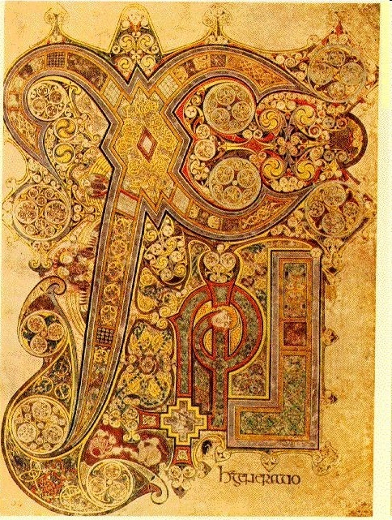
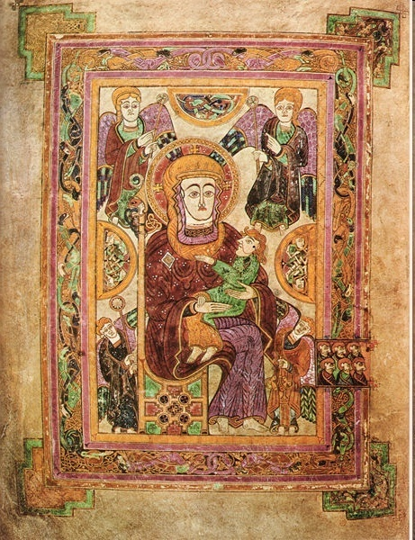
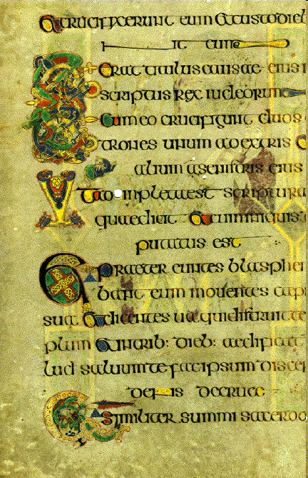
Art
Book of Kells
Dublin, Ireland
Illumination—decoration of books or manuscripts

Slide 7
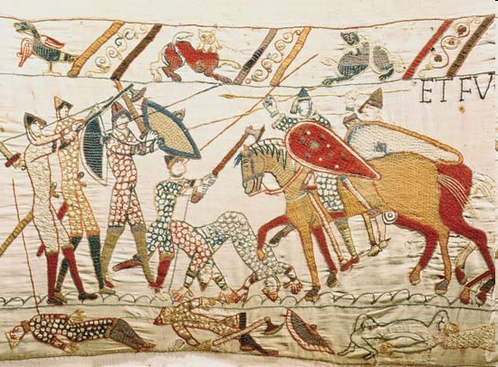
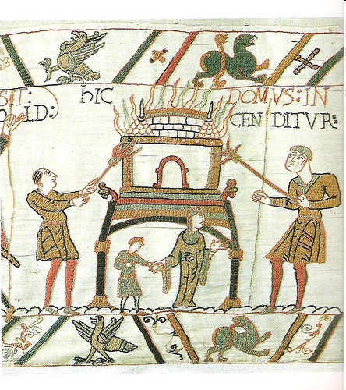
Tapestries
“Woven Paintings”
Functional art, Medieval documents
Bayeux Tapestry—William the Conqueror

