Slide 1
Exploration

Slide 2
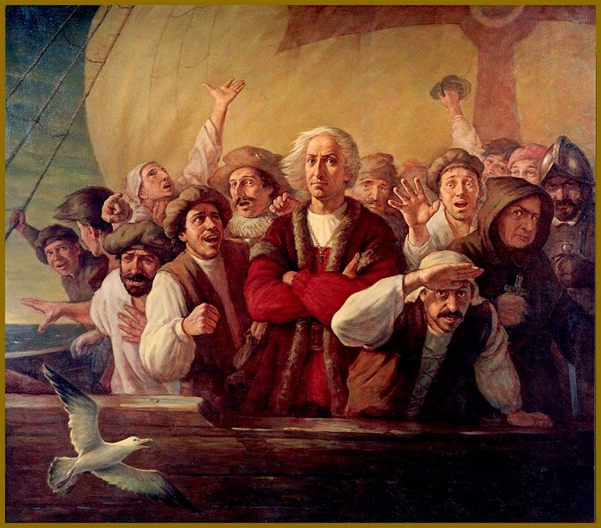
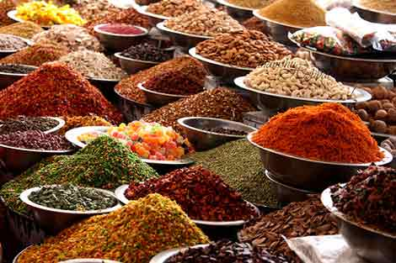
Reasons:
Glory, God, Gold
Spirit of the Renaissance
Spread Christianity
Need new resources/trade
Want to go to India
Spices!

Slide 3
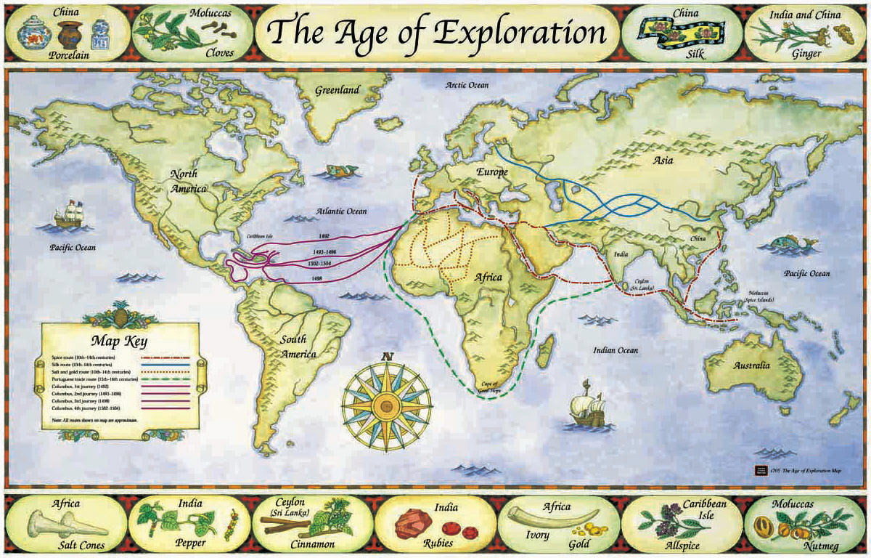
Why do they go the long way?
Land is too dangerous
Med already controlled
Need their own route

Slide 4
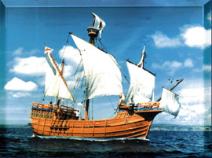
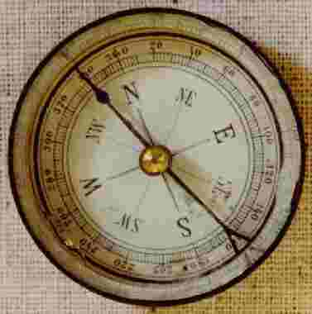
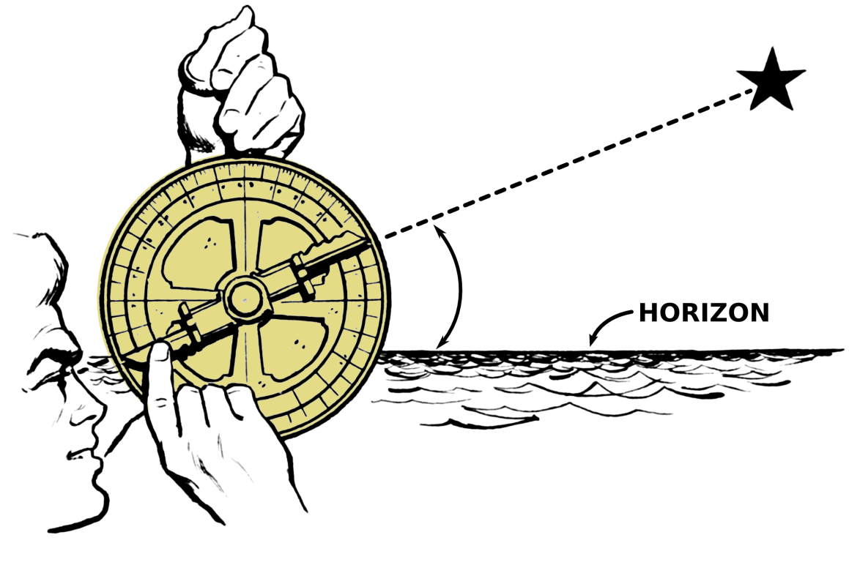
New technology—better ships, navigation

Slide 5
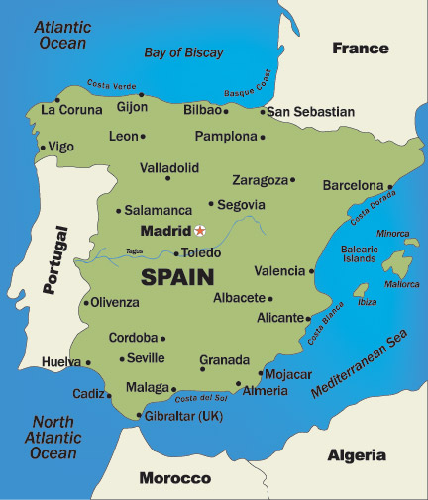
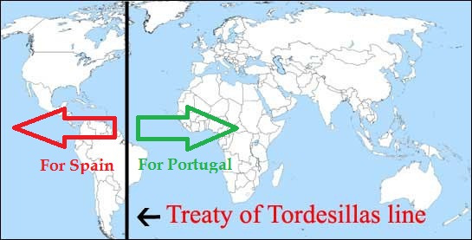
Dividing the World
Spain and Portugal
Biggest European powers
Wealthy
Best navigation technology
Battle over the New World
Both want control
Battle for power
Pope divides world:
Line of Demarcation

Slide 6
Establishing colonies

Slide 7
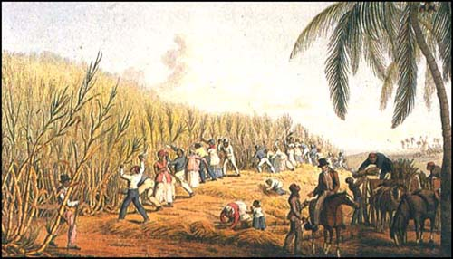
Colonies
More people move to Americas
Mostly in Caribbean
Sugar business

Slide 8
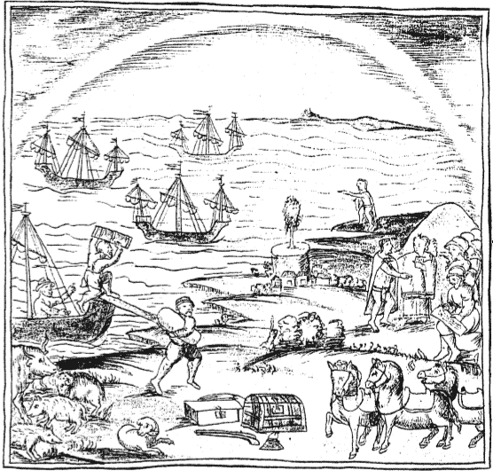
What was the Colombian Exchange?
Massive exchange of plants, animals and diseases.
Moved between the New and Old Worlds.
To the Americas: cows, horses, wheat, smallpox, etc
To Europe: potatoes, tomatoes, tobacco, corn, etc

Slide 9
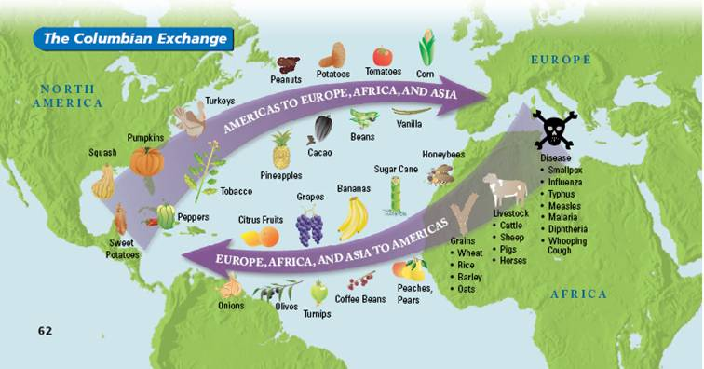

Slide 10
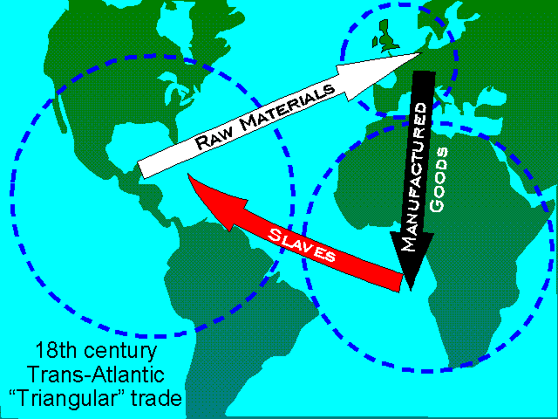
What was the Triangular Trade?
System of trade between Europe, Africa, and the Americas.
Stage 1: Raw materials to Europe (tobacco, rum, sugar)
Stage 2: Manufactured goods to Africa (guns, cloth, rum)
Stage 3: Slaves to the Americas to make raw materials.

Slide 11
The Slave Trade
Europeans use slave labor in their colonies to grow crops, mine, etc.
Native Americans used for awhile
Ineffective
Africans began to be brought
Became main focus of Europe’s relations with Africa.

Slide 12
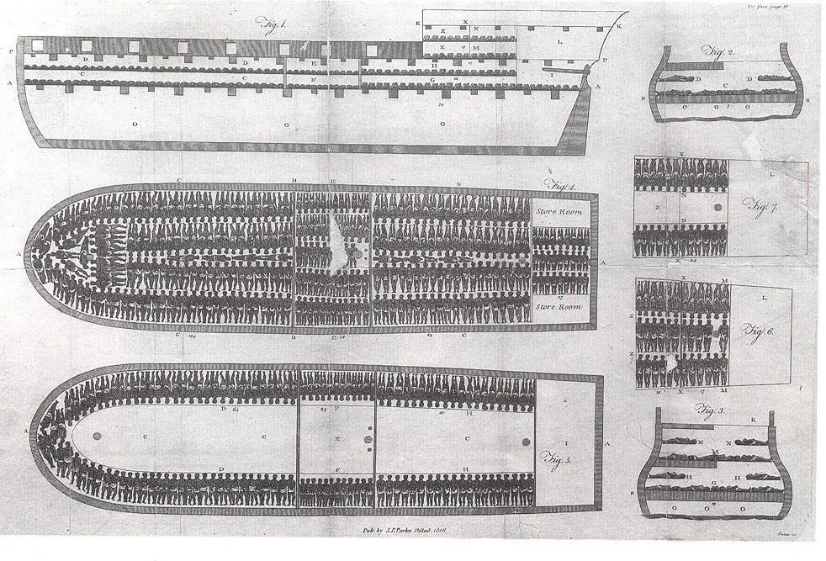

Slide 13
Mercantilism
Economic theory
Idea of selling more goods than you buy (favorable balance of trade)
The government should play a big role in the economy to control this

Slide 14
Capitalism
Economic system based on private ownership and the investment of wealth for profit

Slide 15
$ $ $ In America $ $ $
Tobacco became a primary crop in N. America
Equaled profit for Americas and European sponsors

Slide 16
Joint-Stock Company
Worked like a modern-day corporation
Wealthy people fund a venture/colony in hopes of a profitable return
Jamestown, England’s 1st Colony was funded by a Joint-Stock Company

