Slide 1
Causes
Nationalism
Nation-States within empires looking for self-determination
Militarism
German military build-up makes Allies nervous
Imperialism
Conflict over colonies
Conflict spills into colonies (What makes this a true World War)
Alliances
Draws other nations into small conflicts

Slide 2
Spark of the War
Powder Keg
Europe is ready to blow
Bosnia tries to break away from Austria to join Serbia
Assassination
Serbian terrorist group The Black Hand kills Austrian Archduke Franz Ferdinand
Austria threatens to send troops
Russia threatens Austria
Germany threatens Russia
France threatens Germany
Germany threatens France
Britain threatens Germany
You get the idea….

Slide 3
Sides
Central Powers
Germany
Austria-Hungary
Ottoman Empire (Turkey)
At first Italy
Allied Powers
Britain
France
Russia
Eventually USA (1917)
And Italy switches side

Slide 4
Fighting
Schlieffen Plan
Plan to avoid 2 fronts, quickly defeat the French and turn to Russia
Trench Warfare
Slow, hard, miserable
Weapons
Mechanized war: Tanks, planes, flamethrowers, machine guns
Chemical war: poison gas
Eastern Front
Russian front
Western Front
French front

Slide 5
Impact on Life
Total War—
War on civilians (non-military)
Destroy cities, towns
Propaganda—
Selling the war to citizens
Posters, movies, etc
Rationing—
Save/grow own food
Women—
Men go to fight, women go to work

Slide 6
GERMANY
GREAT BRITAIN

Slide 7
U.S.A
GREAT BRITAIN

Slide 8
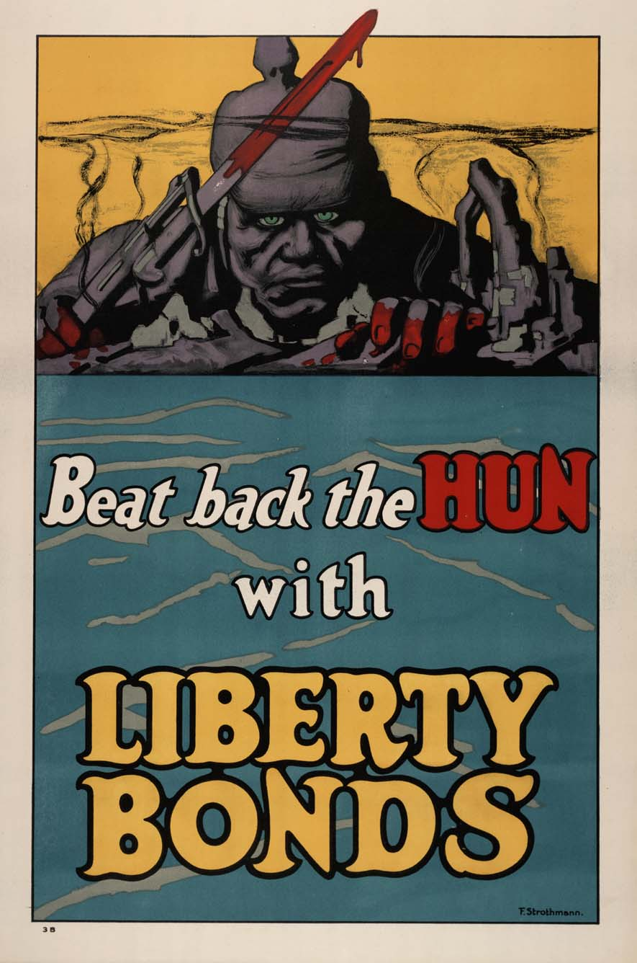
GREAT BRITAIN
GERMANY

Slide 9
End of the War
American joins in 1917
Boosts morale of Allies
Treaty of Brest-Litvosk—
Russia drops out (Revolution at home, establishment of USSR)
Armistice
The eleventh day, in the eleventh month, at the eleventh hour (Nov 11, 1918)
Germany surrenders

Slide 10
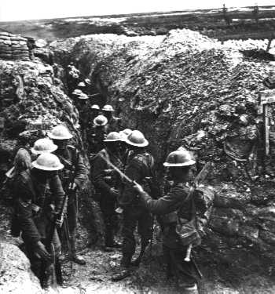
Legacy of WWI
Cost
$338 Billion
Euro cities destroyed
22 Million deaths—1/2 non military
“Lost Generation”
18-30 yr old men
Shell Shock (PTSD)/Survivors’ guilt
New Tech—change how war is fought

Slide 11
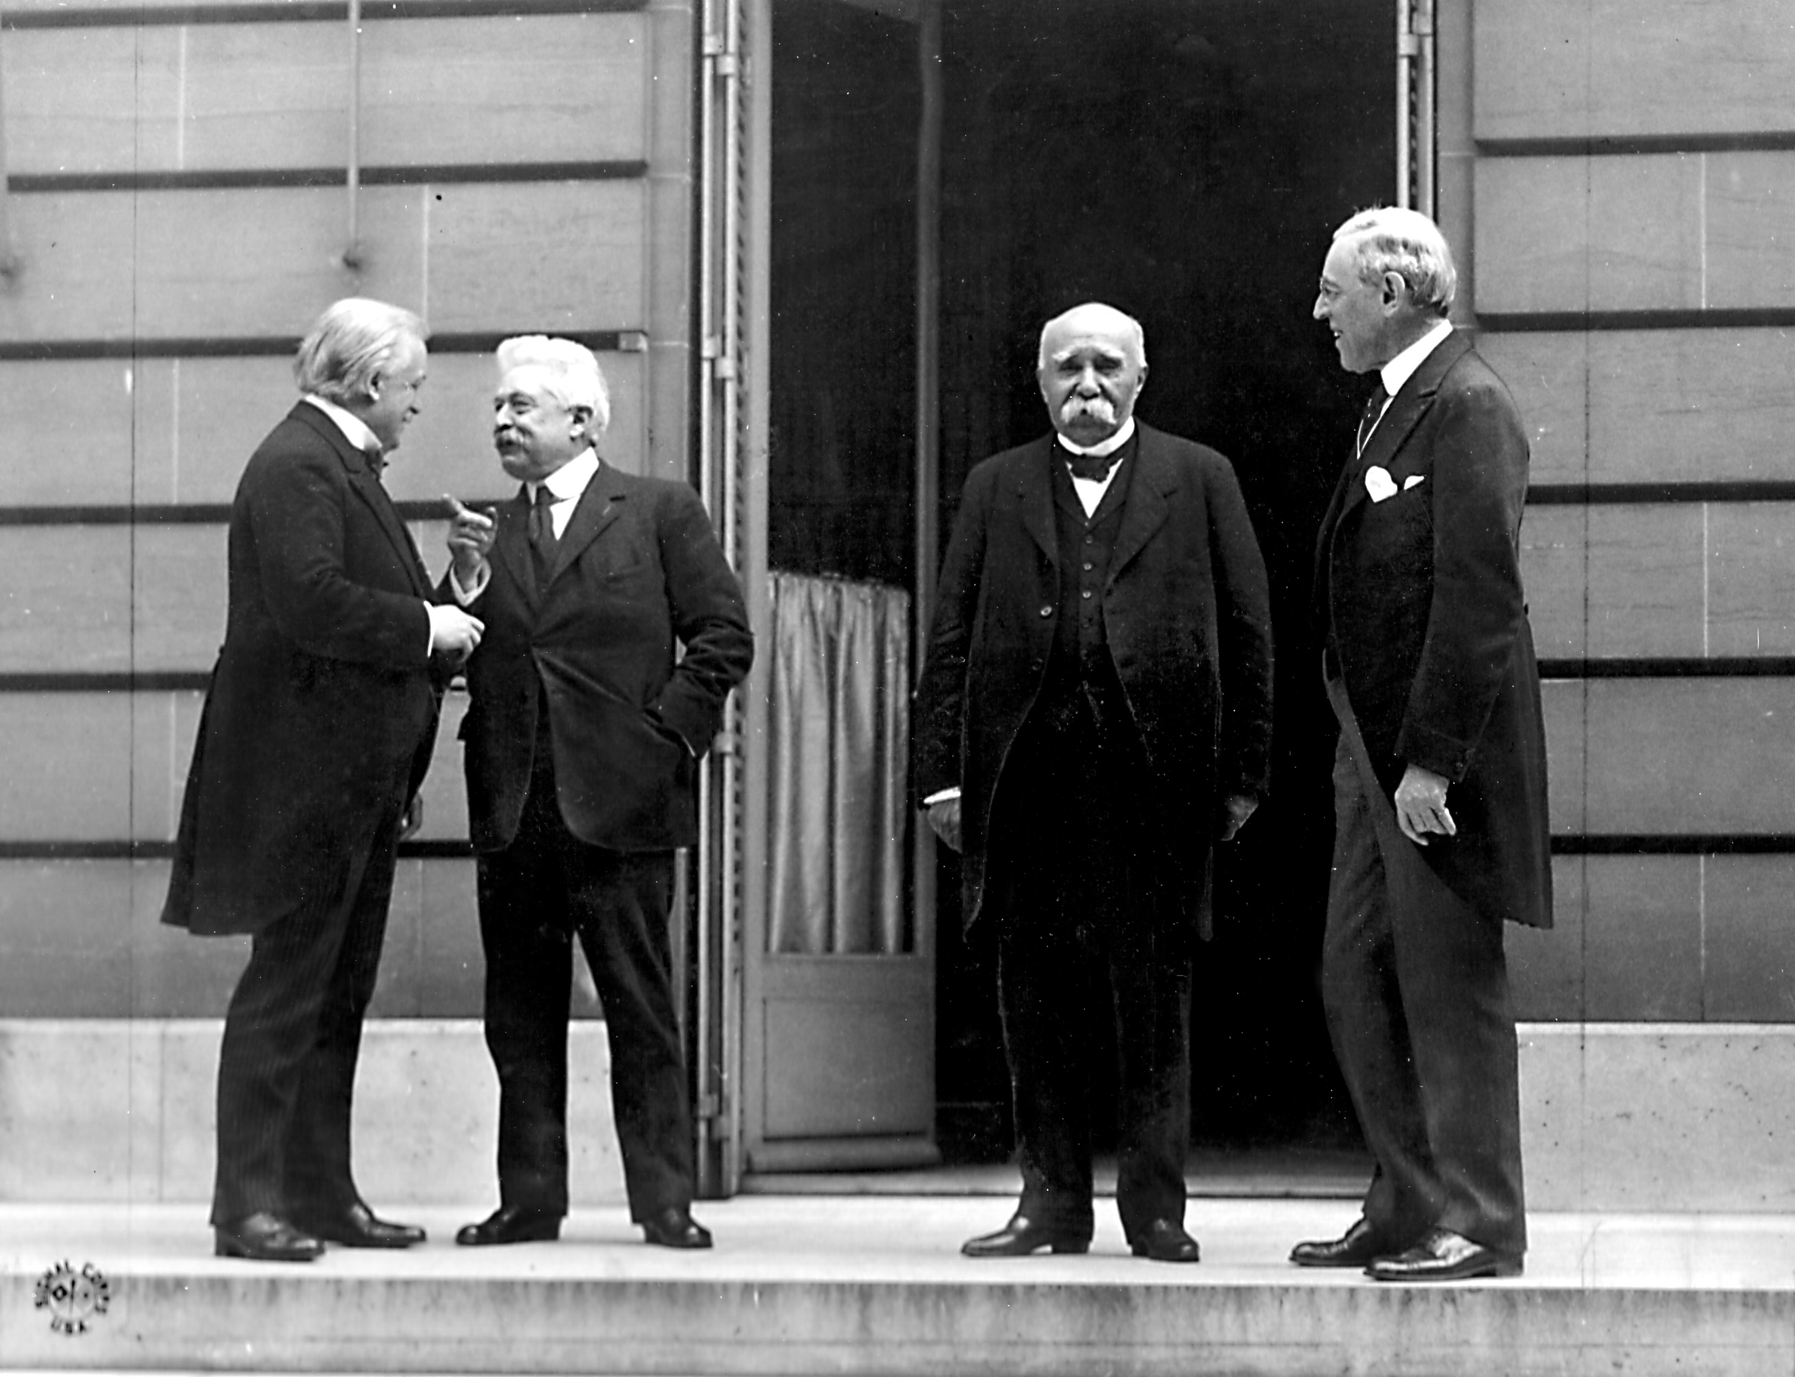
The Big Four
Wilson, USA—wants peace
Orlando, Italy—wants to fit in
Clemenceau, France—want revenge!
George, Great Britain—want revenge!
Russia not invited
Germany not invited

Slide 12
Treaty of Versailles
League of Nations
Part of 14 points
Create a worldwide peace keeping org.
War Guilt Clause
Germany forced to take blame
Cut military
Pay back (reparations) Allies for cost of war
Self-Determination
Countries choose boundaries
Break up of A-H and Ottoman Empire
German & Austrian colonies given to Britain and France (“Mandates”)

Slide 13
Treaty of Versailles
Issue | Treaty Settlement | Problem
War Debt | Germany had to pay reparations for war | Hurt Germany’s economy
Fear of German Strength | Limits German military | Germany resents these demands
Nationalism | Created new states/countries | Some ethnic groups had unwanted minorities in their state
Colonies | Gave some of Germ/Austria’s colonies to GB/France (mandates) | Added to Imperialism rather than solving it
Worldwide peace | Created League of Nations | US didn’t join, weakens League’s power, ineffective

