Slide 1
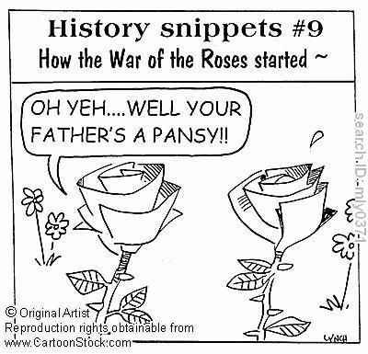
A Brief History of the Plantagenets & the Tudors
Or: A long and complicated stint in British History when everyone was named either Edward, Richard, or Henry.

Slide 2
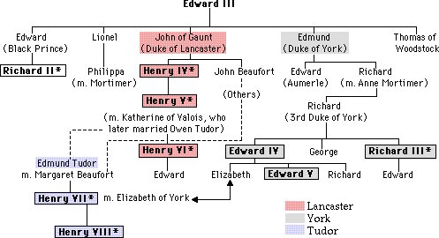
Lancaster v. York
King Edward Plantagenet III's two sons the Duke of Lancaster and the Duke of York, and their descendents

Slide 3
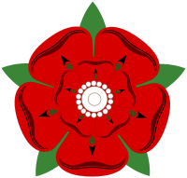

The War of the Roses: The Cousin’s War
Series of Civil Wars over 30 years
  Lancasters v. Yorks
Lancaster descendents hold throne
Henry V is powerful: his son is not
  Sparks conflict

Slide 4
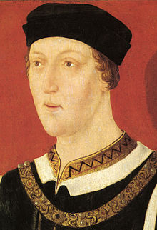
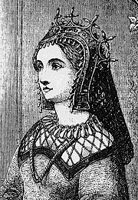
Henry VI
Son of Katherine of Valois and King Henry V
Henry V dies young, Henry VI becomes 5 yr old king
  Controlled by counselors (uncles)
  Strange, quiet, pious child
Marries Margaret of Anjou—very powerful, strong
  Have one son
Henry VI has a mental breakdown

Slide 5
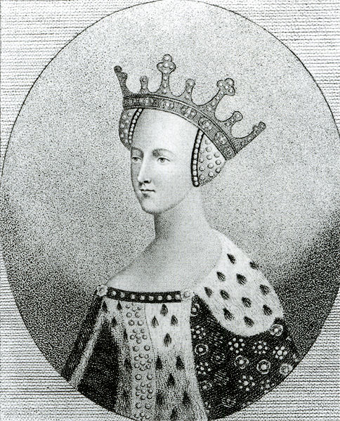
Meanwhile…
Henry VI’s mother, Katherine secretly marries her servant man, Owen Tudor
Have two sons:
  Edmund Tudor
  Jasper Tudor
Edmund marries
Margaret Beaufort,
a distant cousin of Henry VI

Slide 6
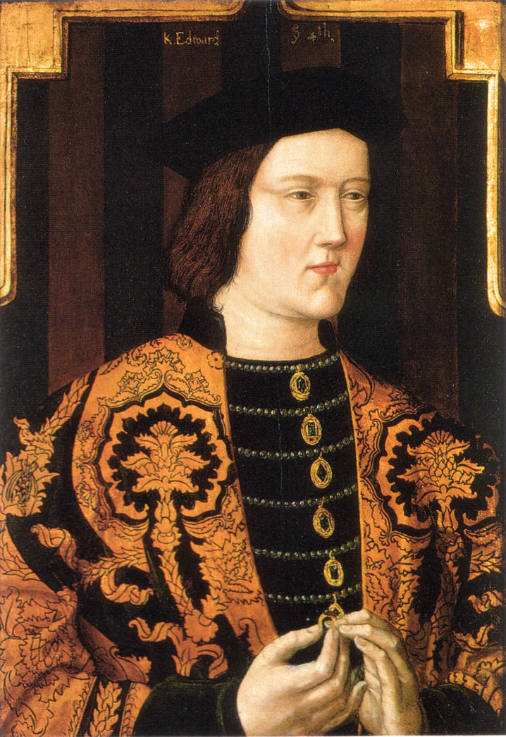
Edward IV
Richard, Duke of York, battles for power against Margaret of Anjou and Henry VI
Richard dies, his son Edward takes control
  Henry overthrown
  Edward becomes King
Married to Elizabeth Woodville
  Eldest children: Elizabeth, Edward, & Richard

Slide 7
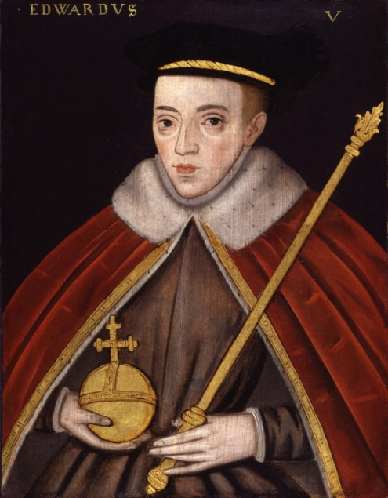
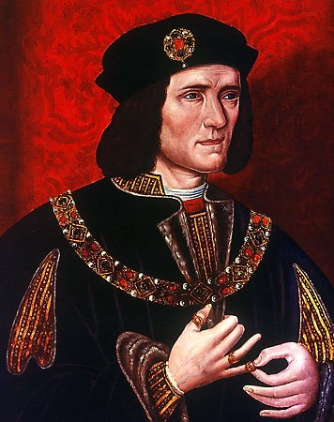
Edward IV
Rebellion in reign, but regains throne
Reigns a total of 20 years, until death
Leaves 12 year old son king Edward V, with Edward IV’s brother Richard as protectorate

Slide 8
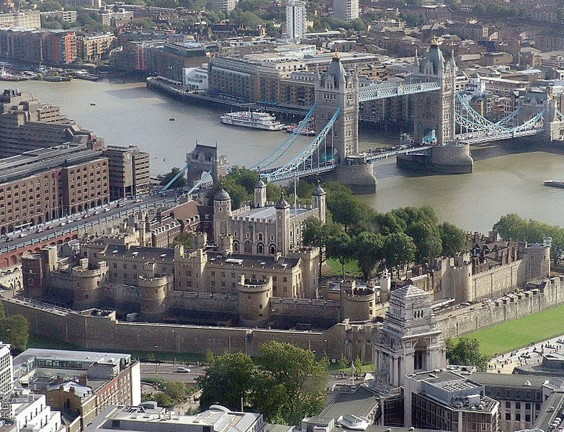
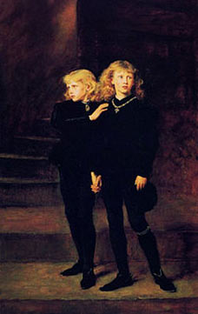
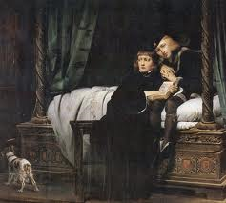
But then there’s Richard
Moves Edward to the Tower of London “for safety”
Mysteriously postpones coronation
Brings young Edward’s 9 year old brother Richard to Tower
By end of 1483…no one sees the young princes in public
Richard is crowned king Richard III
So what happened to the Princes
in the Tower?

Slide 9
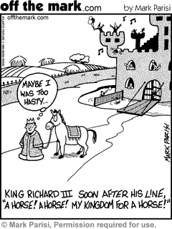
Enter: Henry Tudor
Son of Edmund Tudor & Margaret Beaufort
Leads an army against Richard III’s army
Bosworth Field: So the story goes—kills Richard and takes up his crown from the battlefield

Slide 10
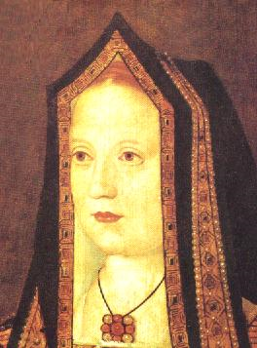
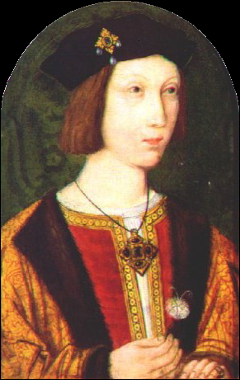
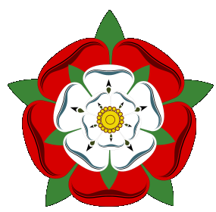
Henry VII
Henry Tudor is crowned Henry VII, King of England
He marries Elizabeth of York, daughter of Edward IV—uniting the Lancaster and York lines under the Tudor name ending the War of the Roses

Slide 11
A New Era: The Tudor Dynasty

Slide 12
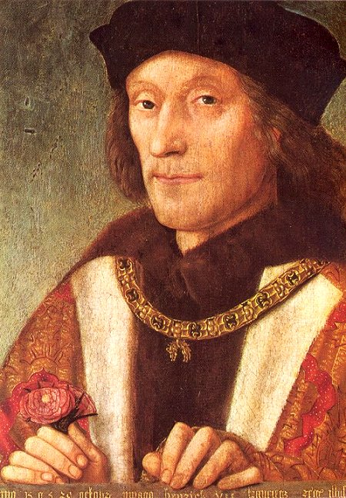
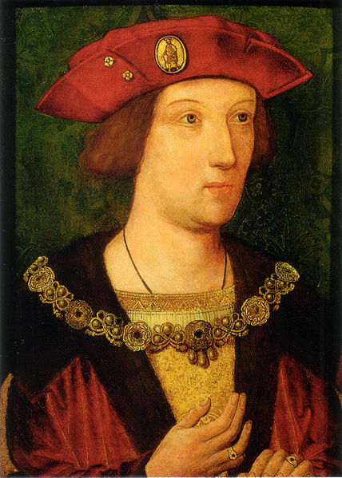
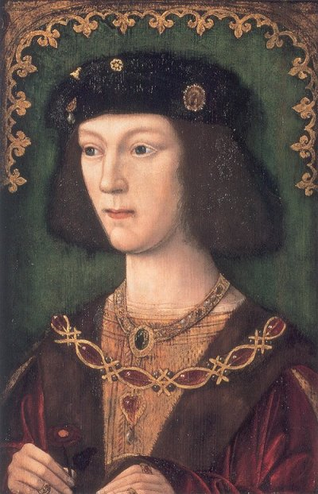
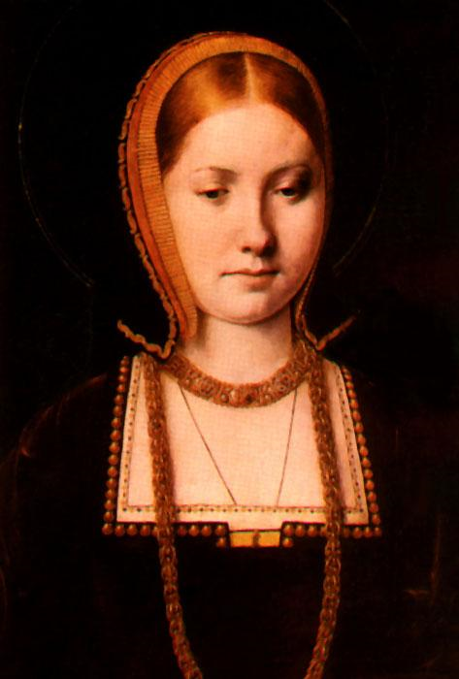
Henry VII & His Sons
Henry VII rules 23 years
Has 2 sons: Arthur (destined to be king) and Henry (destined for the church)
Arthur marries Spanish princess Catherine of Aragon (daughter of Ferdinand and Isabella)
  He dies not long after
Henry will fall in love with and marry Catherine, although she is older

Slide 13
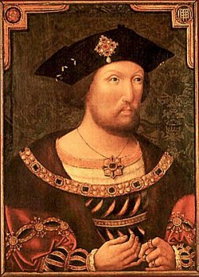
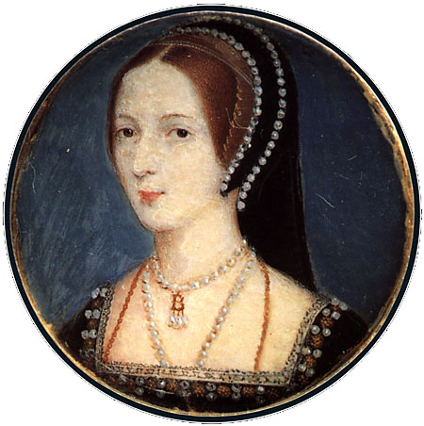
How Henry VIII Changes the English Church
1509—Henry VIII marries his late brother’s wife, Catherine of Aragon, they will have one child: Mary Tudor
1521—Henry criticizes Luther & is called “Defender of the Faith” by the pope
1525—Henry greatly desires a male heir. He meets Anne Boleyn & asks the pope to annul his marriage to Catherine; the pope refuses
1529—Parliament passes laws putting Henry in control of the English church instead of the pope
1533—Henry divorces Catherine and marries Anne; their daughter Elizabeth is born
1534—Act of Supremacy: Henry is “the only supreme head on Each of the Church of England.” Many are executed, including Henry’s friend Thomas More.

Slide 14
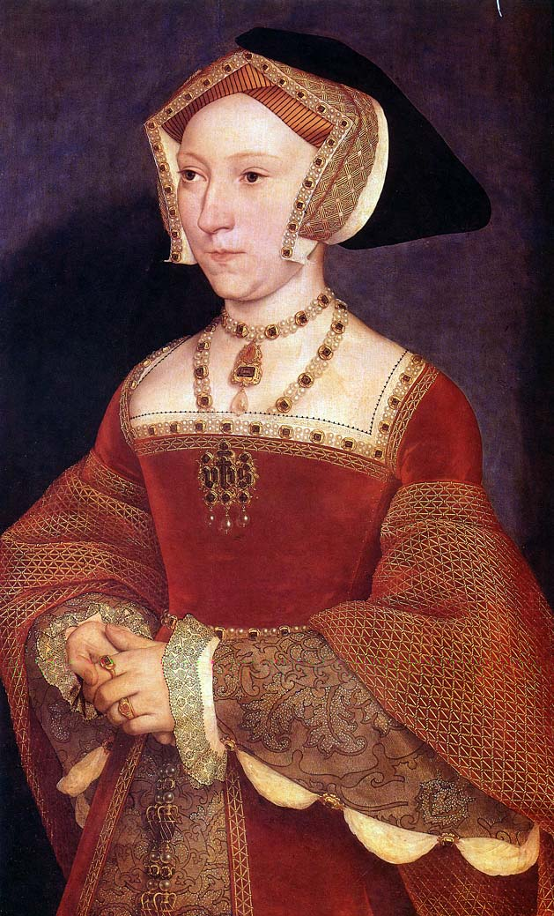
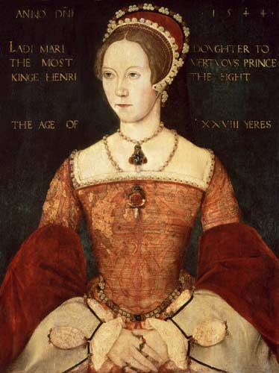
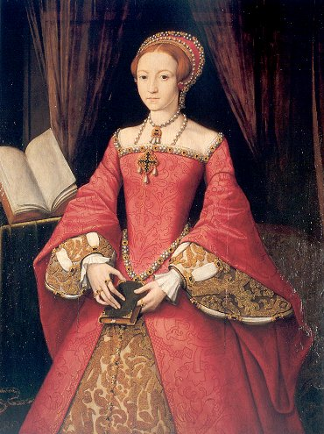
But what’s the problem?
Neither the Princess Elizabeth nor Princess Mary is an heir…
Henry tires of Anne & becomes suspicious—she is beheaded for treason when Elizabeth is 4
One Week Later: Henry marries Jane Seymour
  She gives birth to a son BUT dies in childbirth

Slide 15
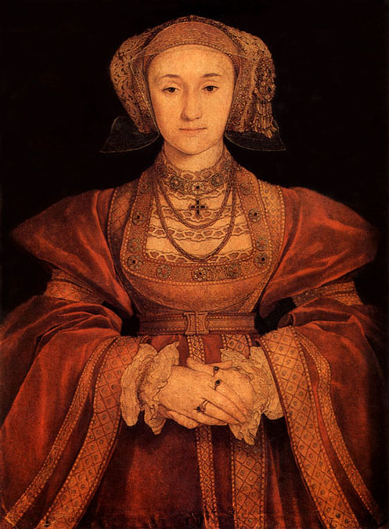
So What Does Henry Need?
A new wife!
Agrees to marry a German princess, Anne of Cleves, based on this portrait:
Unfortunately for Henry,
the artist was generous
to Anne
He divorces her

Slide 16
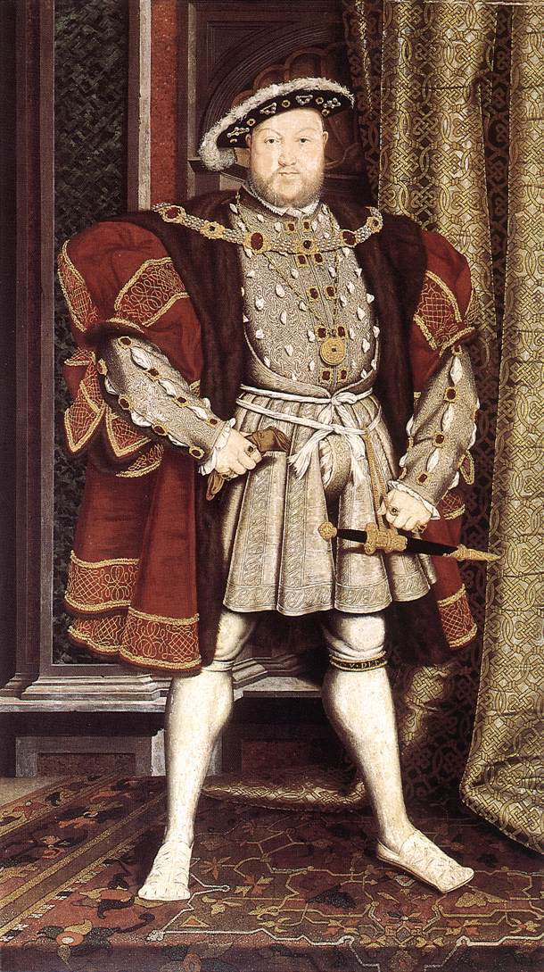
Keep this in Mind: Henry VIII is 49 & Looks A Bit Like This By This Point
Oh yeah,
And one of his legs was injured in a jousting accident and leaked puss, blood, and stench for the rest of his life
So overall, not pleasant

Slide 17
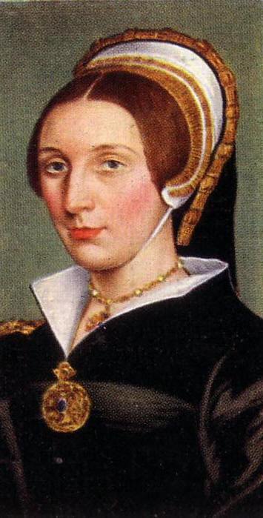
Then Henry Meets Katherine Howard
Katherine is beautiful, flirtatious…
and 15
Henry ’s Katherine
Katherine ’s Other Men
Henry finds out and she is beheaded
  On the block she admits her lover’s name…sucks to be that guy

Slide 18
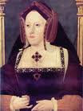
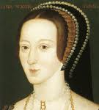
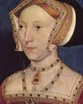
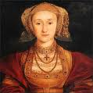

So Thus Far We Have
Divorced (Catherine of Aragon)
Beheaded (Anne Boleyn)
Died (Jane Seymour)
Divorced (Anne of Cleves)
Beheaded (Katherine Howard)
So next must be…

Slide 19
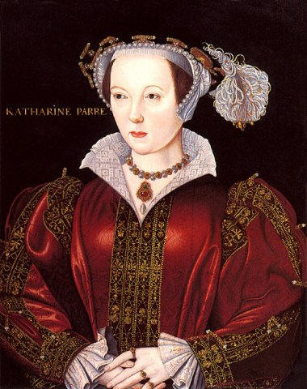
Survived!
Henry marries Catherine Parr
Serves as a nurse and friend until Henry’s death

Slide 20
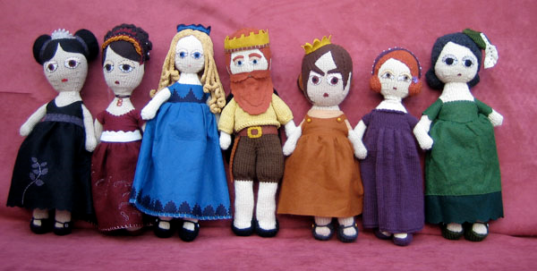
The Six Wives of Henry VIII

Slide 21
Oh while we’re at it..
Henry spent most of time doing 4 things:
  Trying to not go to war with France or Spain
  Burning monasteries and taking their land/wealth
  Putting down rebellions
  Executing people

Slide 22
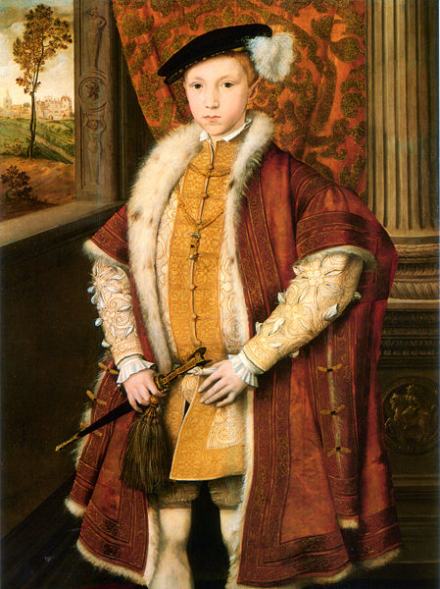
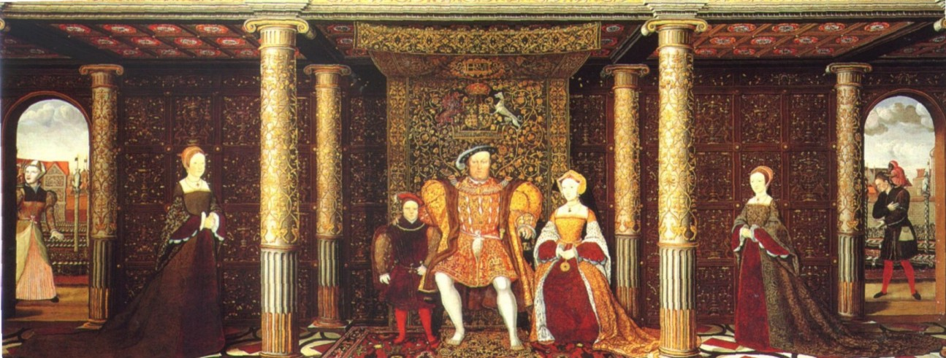
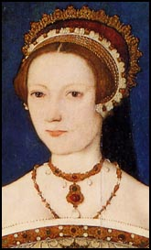
Henry’s Heirs
1547—Henry VIII dies; his son Edward VI becomes king & makes protestant reforms
Edward VI dies
Mary Tudor (His older sister) is unpopular, so his cousin, Lady Jane Grey is made queen for 9 days, she is executed

Slide 23
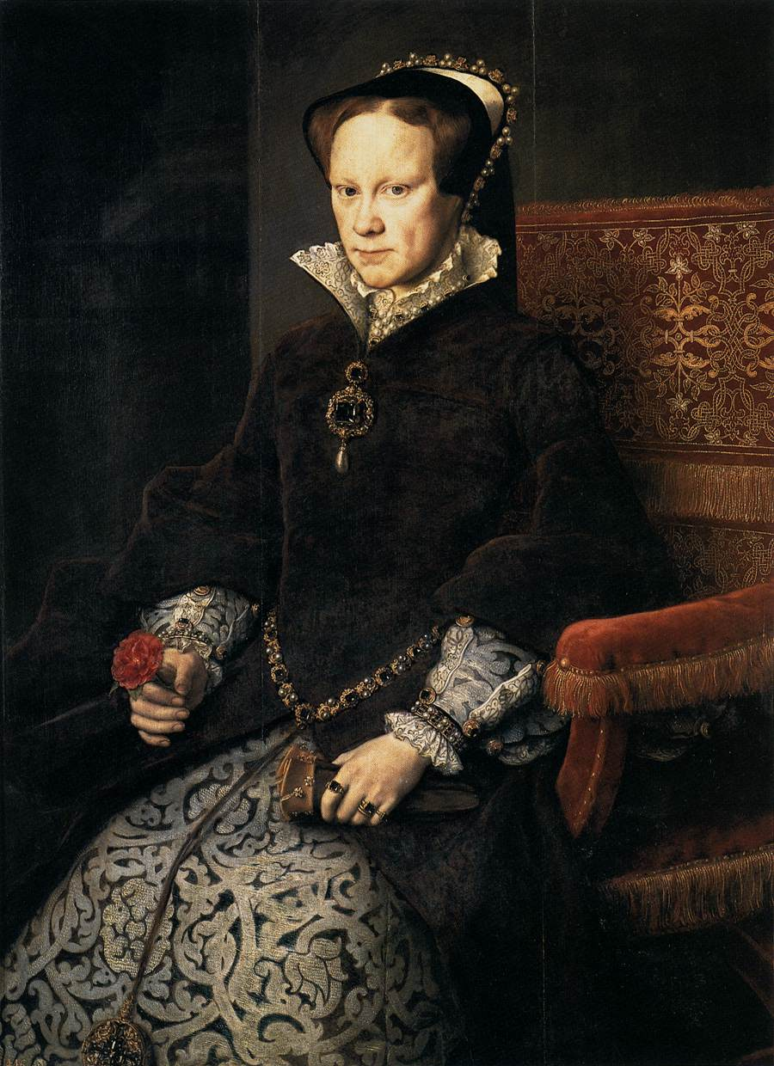
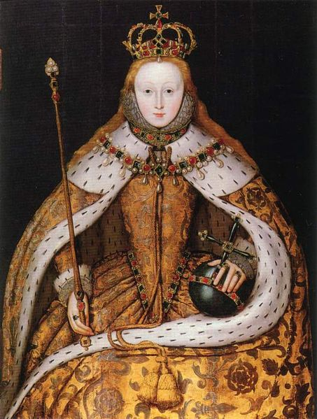
Henry’s Heirs
Mary Tudor becomes queen. Restores Catholicism & burns protestants at the stake “Bloody Mary”
1558—Mary Tudor dies; Elizabeth I becomes queen.

Slide 24
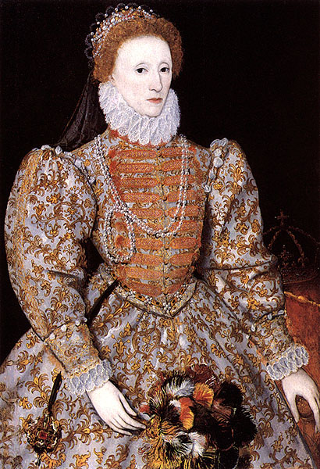
Elizabeth I: Glorianna

Slide 25
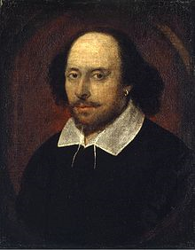
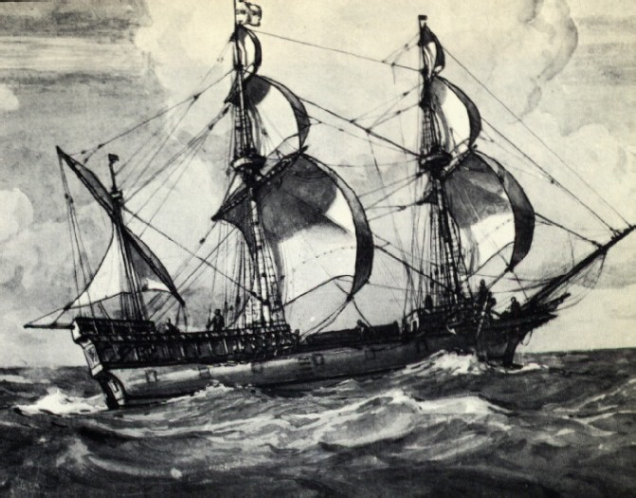
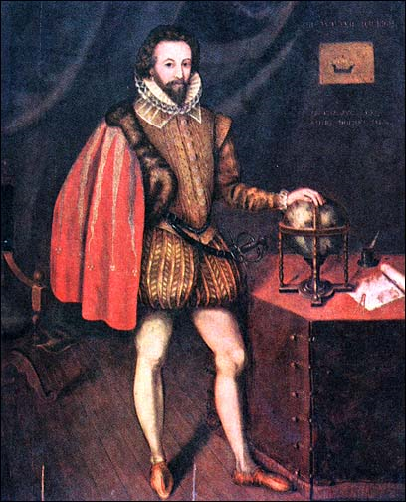
Elizabeth I: Glorianna
Under Elizabeth I England has a Golden Age
  Time of prosperity, learning, and exploration
She never marries; uses marriage as a political tool
  “I have already joined myself in marriage to a husband, namely the kingdom of England.”

Slide 26
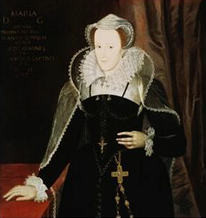
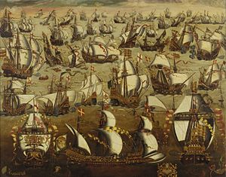
Elizabeth I: Glorianna
Establishes compromises in the church (at first)
  “I do not wish to make windows into men’s souls.”
  Tightens control after catholic cousin Mary, Queen of Scots tried to overthrow her
Conflict with Spain
  King Philip II sends
  fleet of ships called
  the Armada
  Blown off course by a
  storm and fails to attack
Unifies England
Peace WITHIN England almost 26 years

Slide 27
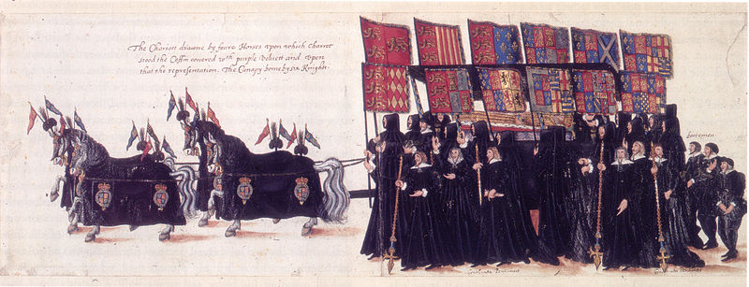
Elizabeth I: Glorianna
Elizabeth died 24 March, 24 1603 at 69 years old
Her cousin, James VI of Scotland (son of Mary Queen of Scots) is named her heir and becomes King James I of England

Slide 28
Now: Your Assignment
As you can see, there was always drama in the Tudor Court. Imagine that you are a newspaper writer of the sixteenth century and you are going to write an exposition article of Henry’s court. You will be given research (because we always base articles on facts) on court life, Henry, and his wives. You may write on any aspect you want. It must be a page in length and include a hand drawn picture (there is no photography after all).

