Slide 1
WWII Escalation Timeline

Slide 2
*Nazi Party wins the majority in the Reichstag (Congress)
*Adolf Hitler b/c chancellor
* Germany leaves the League of Nations
* Nuremberg Laws passed, stripping Jews of civil rights
* German military build up begins
1935
1933

Slide 3
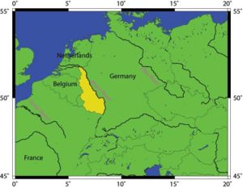
* Invasion of the Rhineland b/w Germany and France
* Germany signs a pact with Italy
* Germany assists dictator Franco in Spain
Map of the Rhineland. Wikimedia Commons.21 Nov. 2008 <http://commons.wikimedia.org/wiki/Image:Rhineland.jpg>.
1936

Slide 4
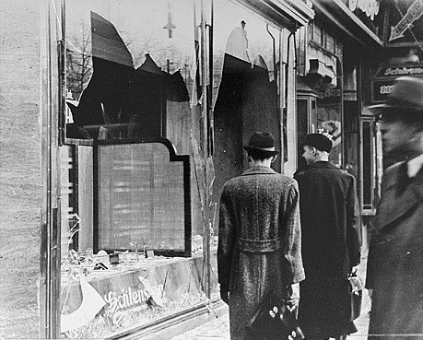
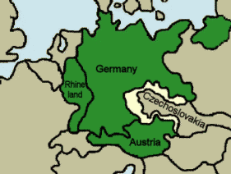
* Krystallnact starts physical violence a/g Jews
* Germany march into Austria
* Germans and British sign Munich Pact giving Hitler part of Czechoslovakia
1938
Crystal Night Photo.. Holocaust Education & Archive Research Team.21 Nov. 2008 <http://www.holocaustresearchproject.org/holoprelude/images/kn2.gif>.
Map of the Sudetenland. History on the Net.21 Nov. 2008 <http://www.historyonthenet.com/WW2/causes.htm>.

Slide 5
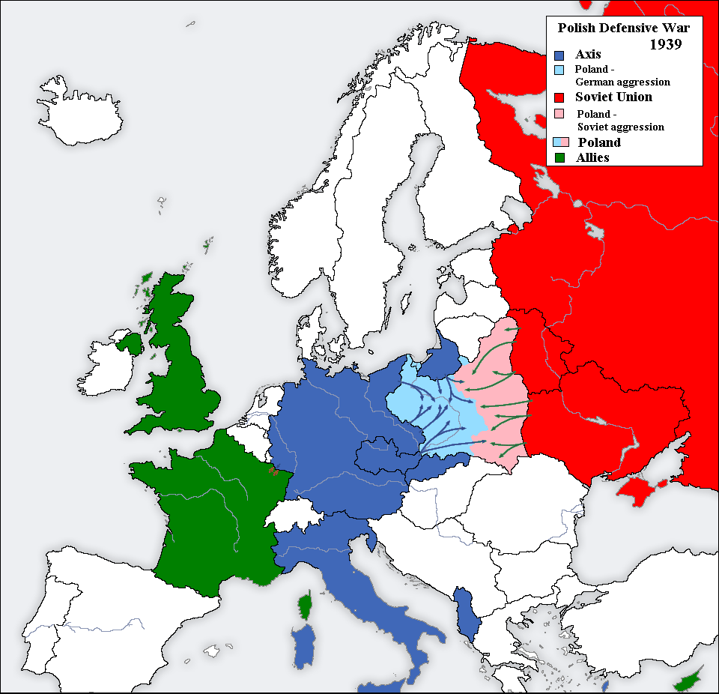
* Czechoslovakia invaded by Germany
* Germany signs nonaggression pact with Russia
* Germany invades Poland
1939
German Invasion of Poland. Owlspace at Rice University.21 Nov. 2008 <https://owlspace-ccm.rice.edu/access/content/user/mab3/justifyingawar.html>.

Slide 6
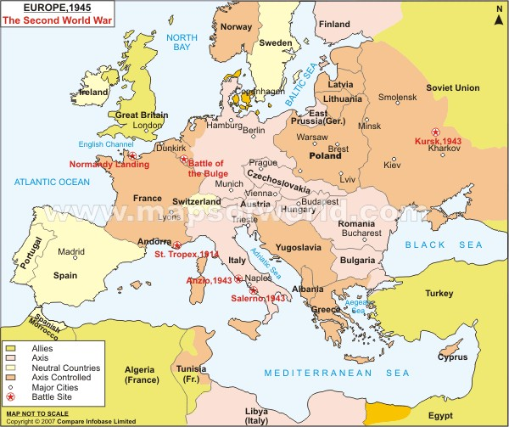
* Germany invades Belgium, Luxemburg, and the Netherlands
* Germany takes over Paris
* Germany battles Britain by air – Battle of Britain
1940
Map of Europe 1945. Maps of the World.21 Nov. 2008 <http://www.mapsofworld.com/world-maps/world-war-ii-map.html>.

Slide 7
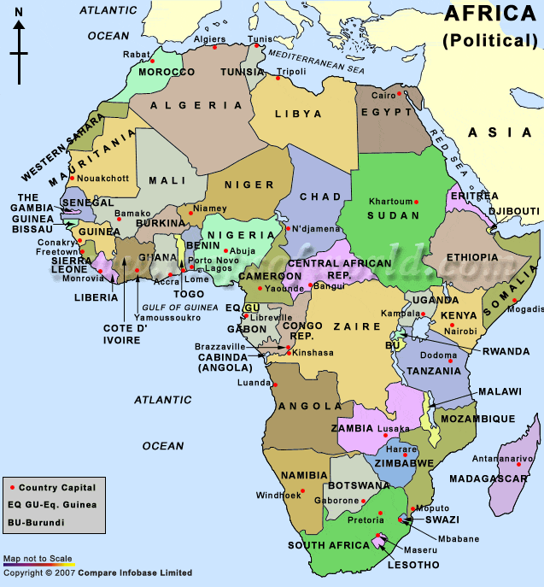
Japan
Japan
Italy
* Italy invades Ethiopia
* The League chooses to not defend Ethiopia
1931
1932
1935
Map of Africa. Maps of the World.21 Nov. 2008 <www.mapsofworld.com/.../maps_of_world_africa.gif>.

Slide 8
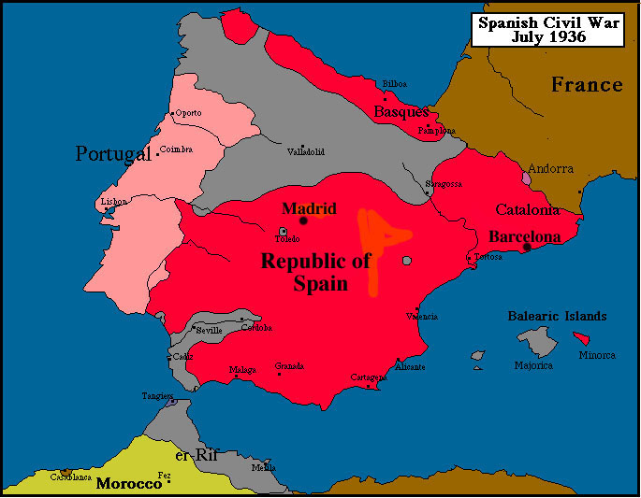
Italy
* Italy signs a pact with Germany
* Italy assists dictator Franco in Spain
1936
Spanish Civil War Map. Heineman Maps.21 Nov. 2008 <www2.bc.edu/~heineman/maps/SpCW5.jpg>.

Slide 9
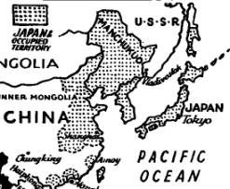
Japan
Military leader Tojo take control of Japan’s government
Japan
Japan leaves League of Nations
Japan
Japan invades Manchuria
1931
1932
1933

Slide 10
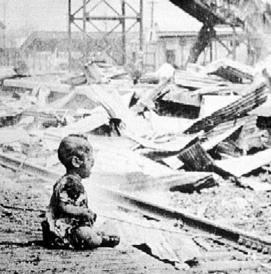
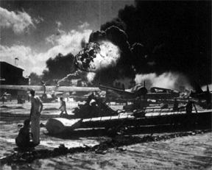
All
Japan, Italy and Germany form an alliance (Axis)
Japan
Japan attacks China
Japan
Japan bombs the US at Pearl Harbor
1937
1941
1940

