Slide 1
World War II: Life at Home

Slide 3
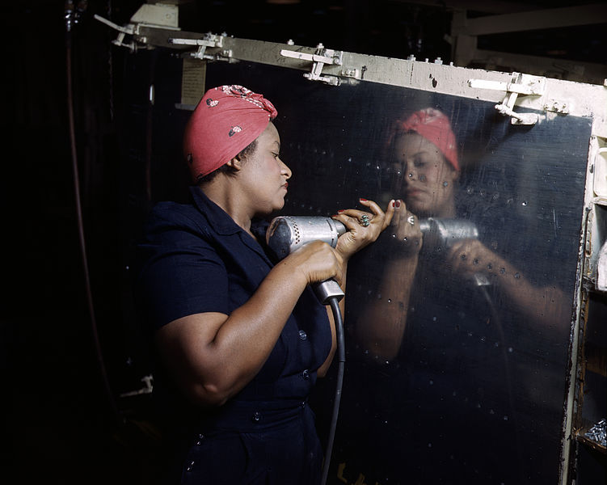

Slide 4
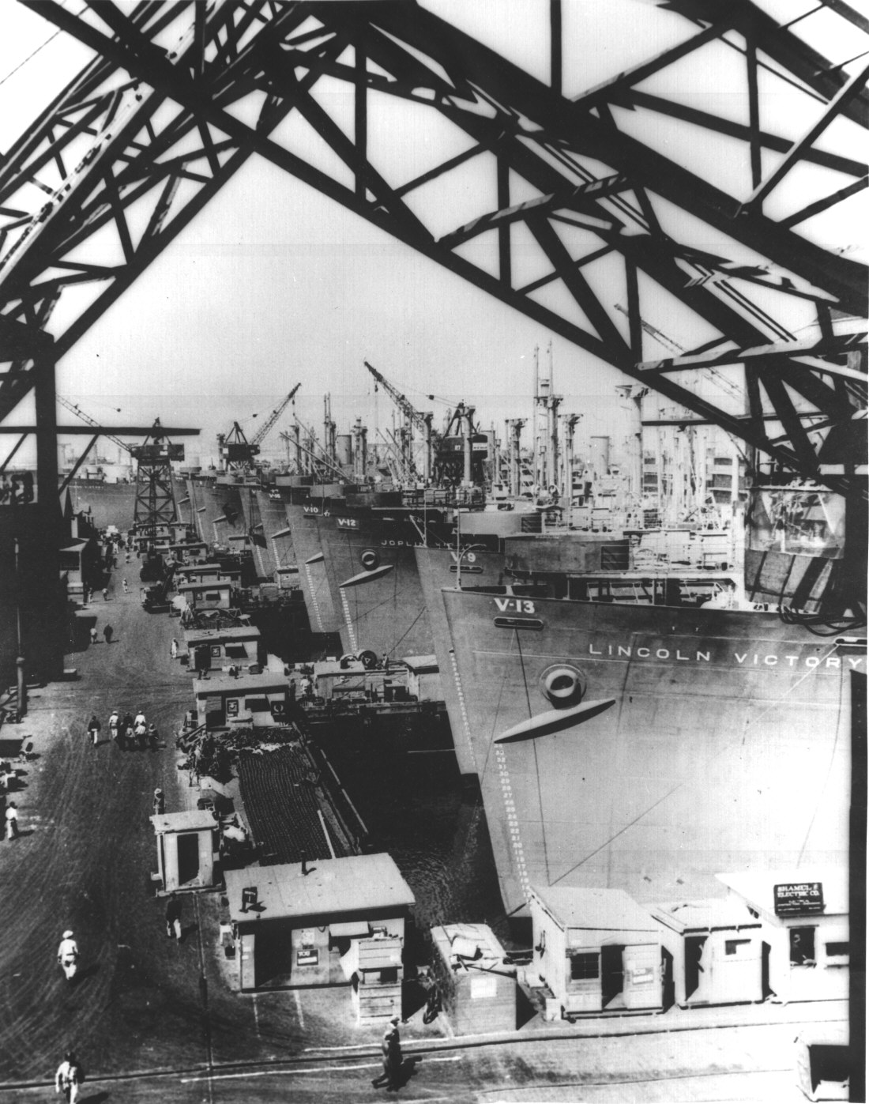

Slide 5
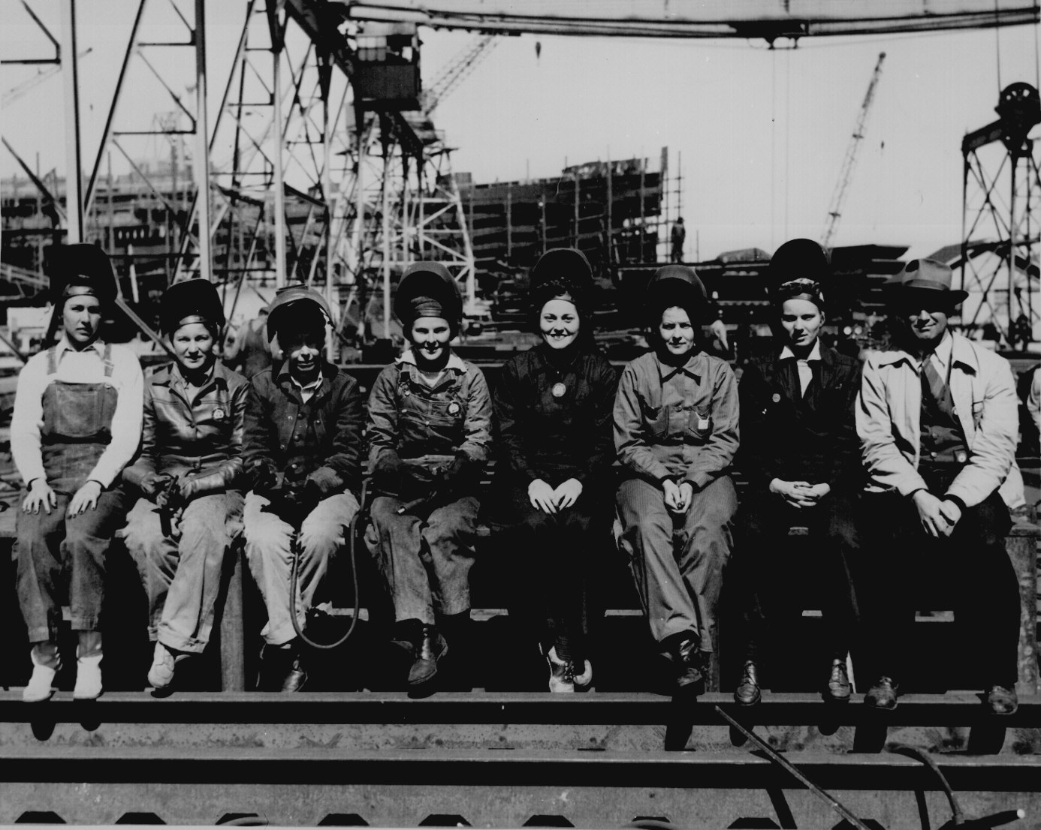

Slide 6
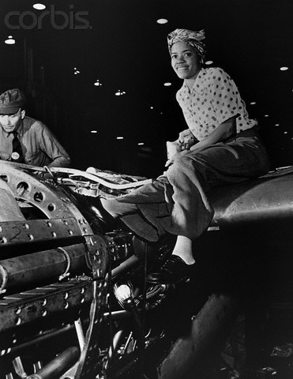

Slide 7
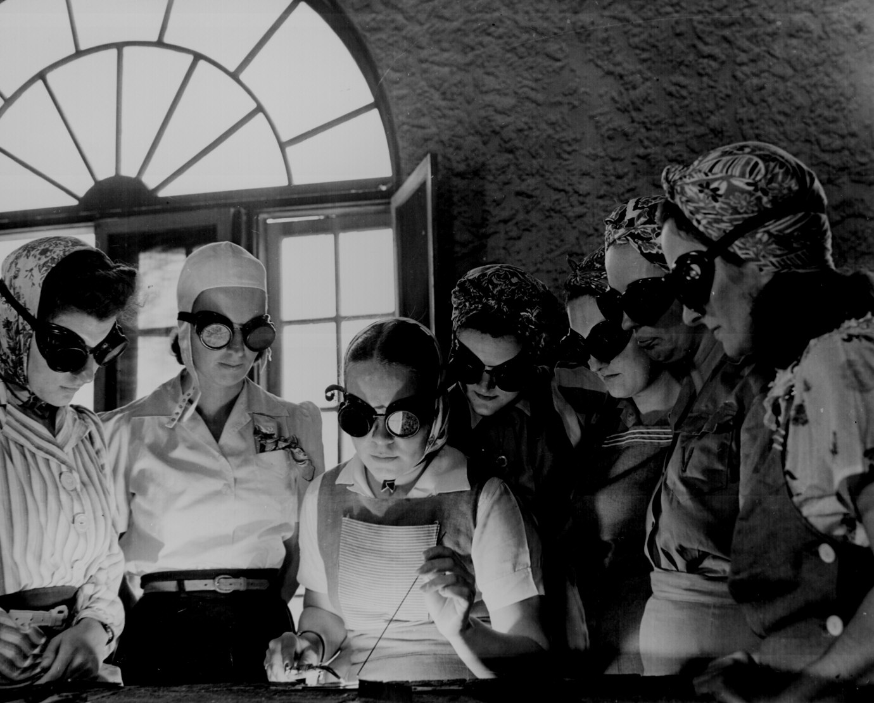

Slide 8
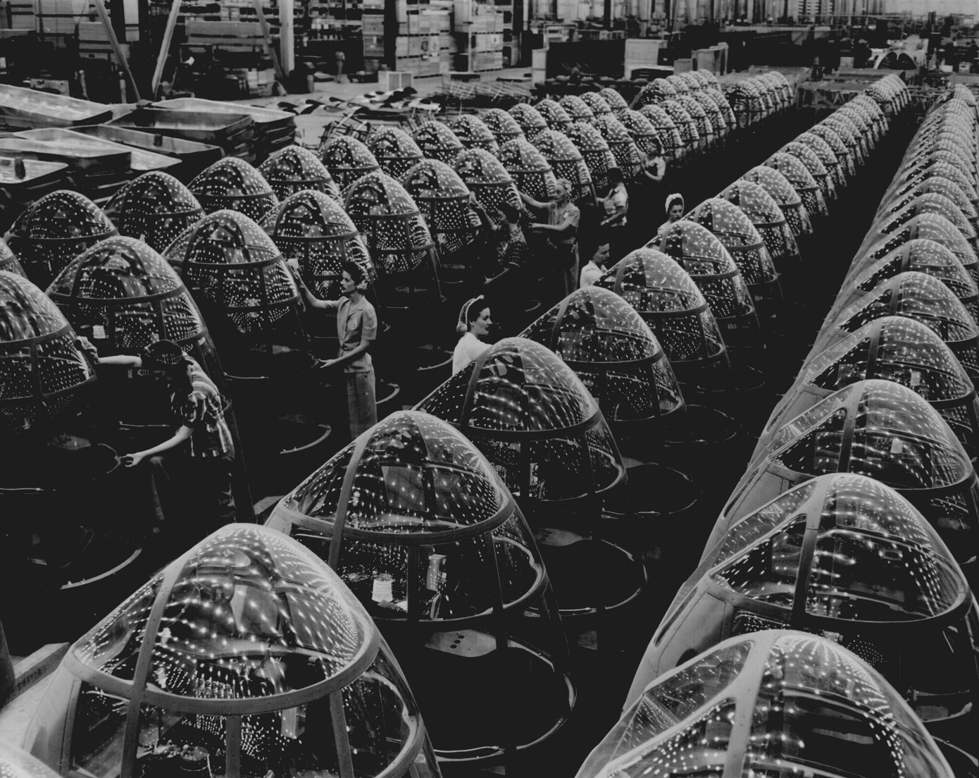
Grooming Nose cones for A-20 Bombers

Slide 9
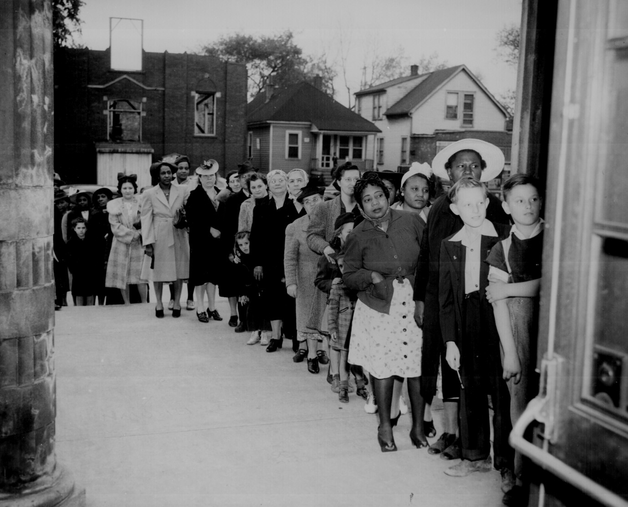
Sugar Rationing

Slide 10
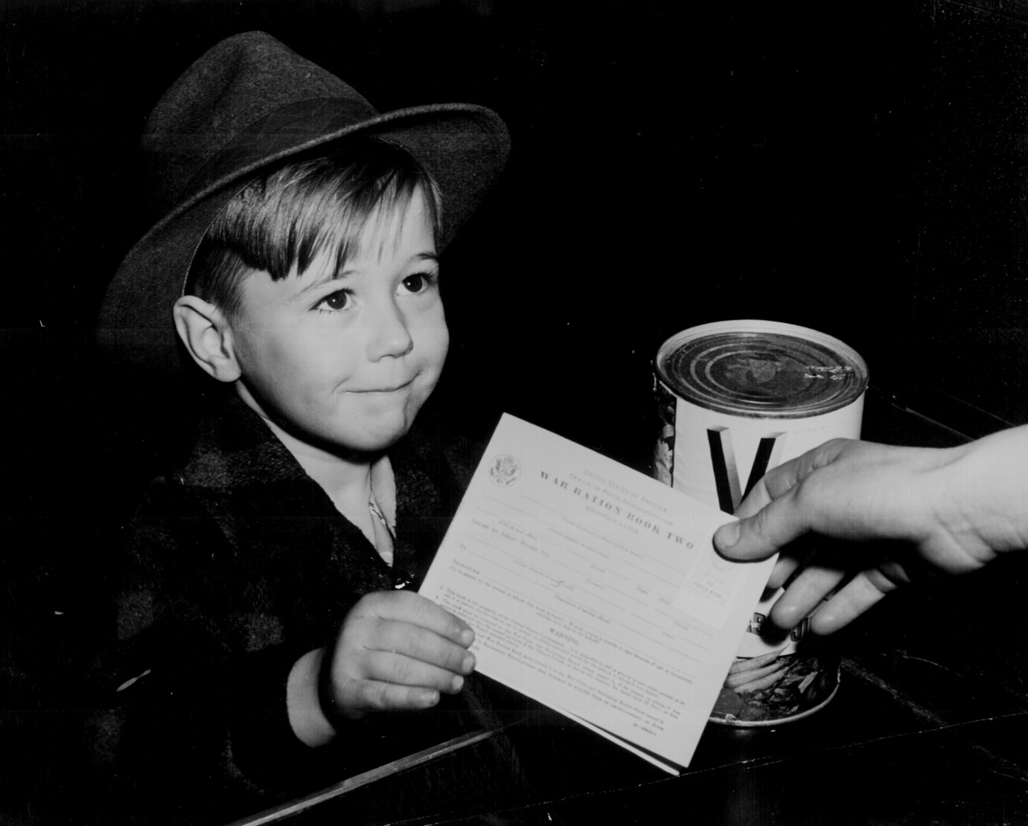
Receiving his first ration book

Slide 11
Victory Gardens

Slide 12
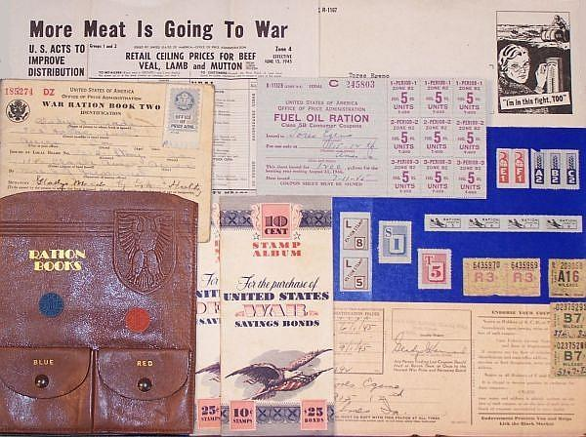

Slide 13
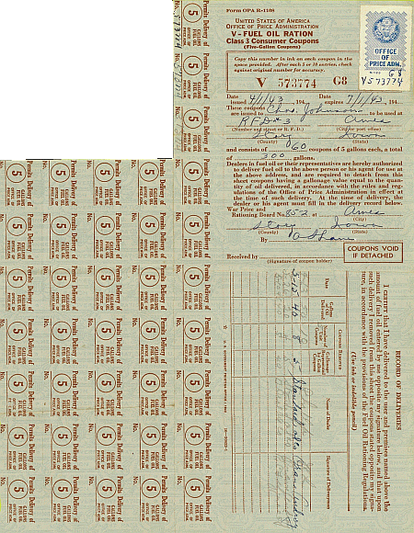

Slide 14
Rationed Items |  | Rationing Duration
Tires Cars Bicycles Gasoline Fuel Oil & Kerosene Solid Fuels Stoves |  | January 1942 to December 1945 February 1942 to October 1945 July 1942 to September 1945 May 1942 to August 1945 October 1942 to August 1945 September 1943 to August 1945 December 1942 to August 1945
Rubber Footwear Shoes |  | October 1942 to September 1945 February 1943 to October 1945
Sugar Coffee Processed Foods Meats, canned fish Cheese, canned milk, fats |  | May 1942 to 1947 November 1942 to July 1943 March 1943 to August 1945 March 1943 to November 1945 March 1943 to November 1945
Typewriters |  | March 1942 to April 1944

Slide 15
Rita Hayworth

Slide 16
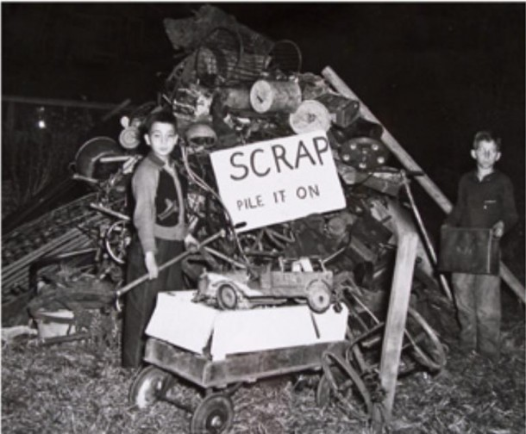
Salvage

Slide 17
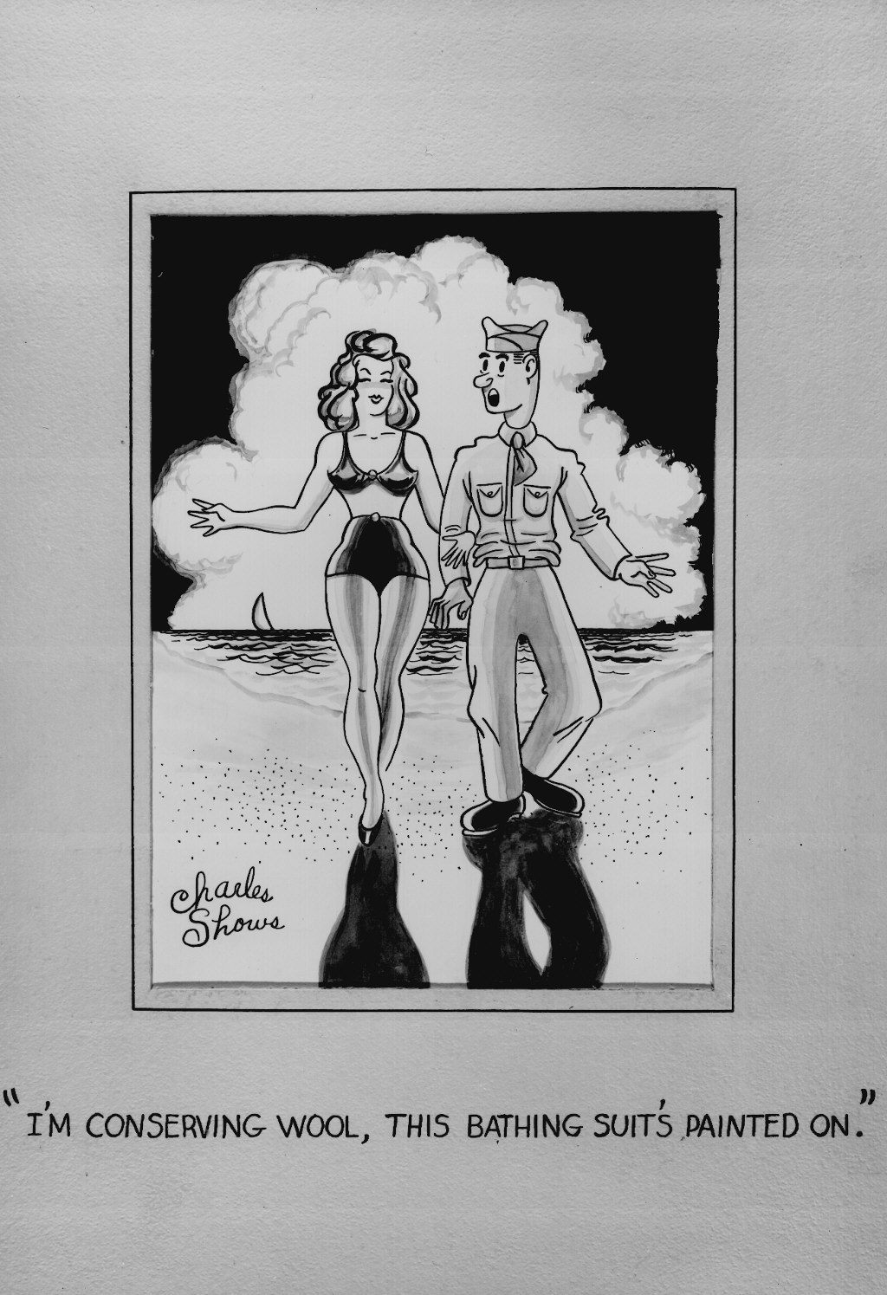

Slide 18
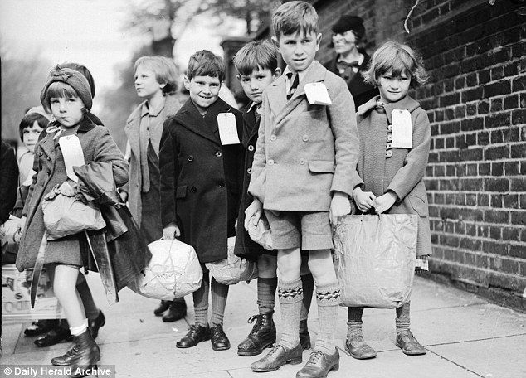
Evacuation of London

Slide 20
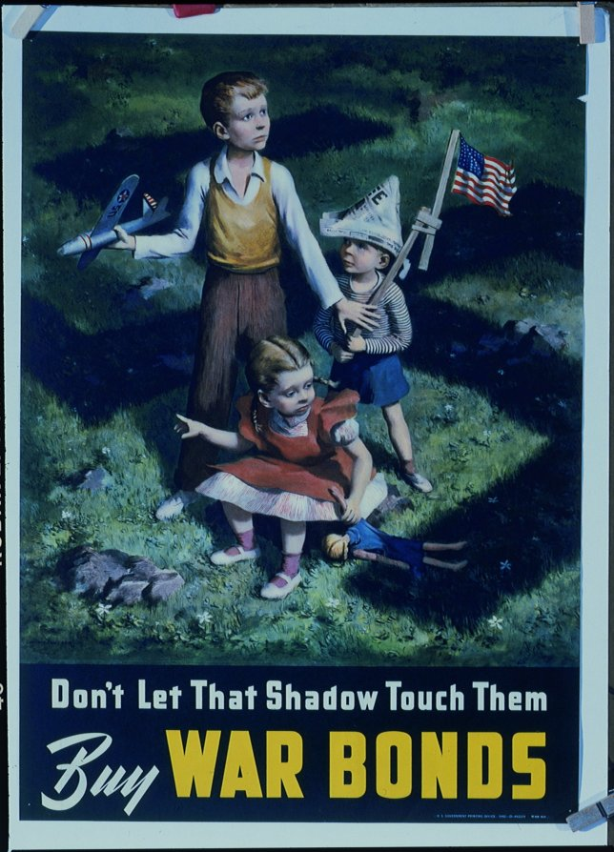

Slide 21
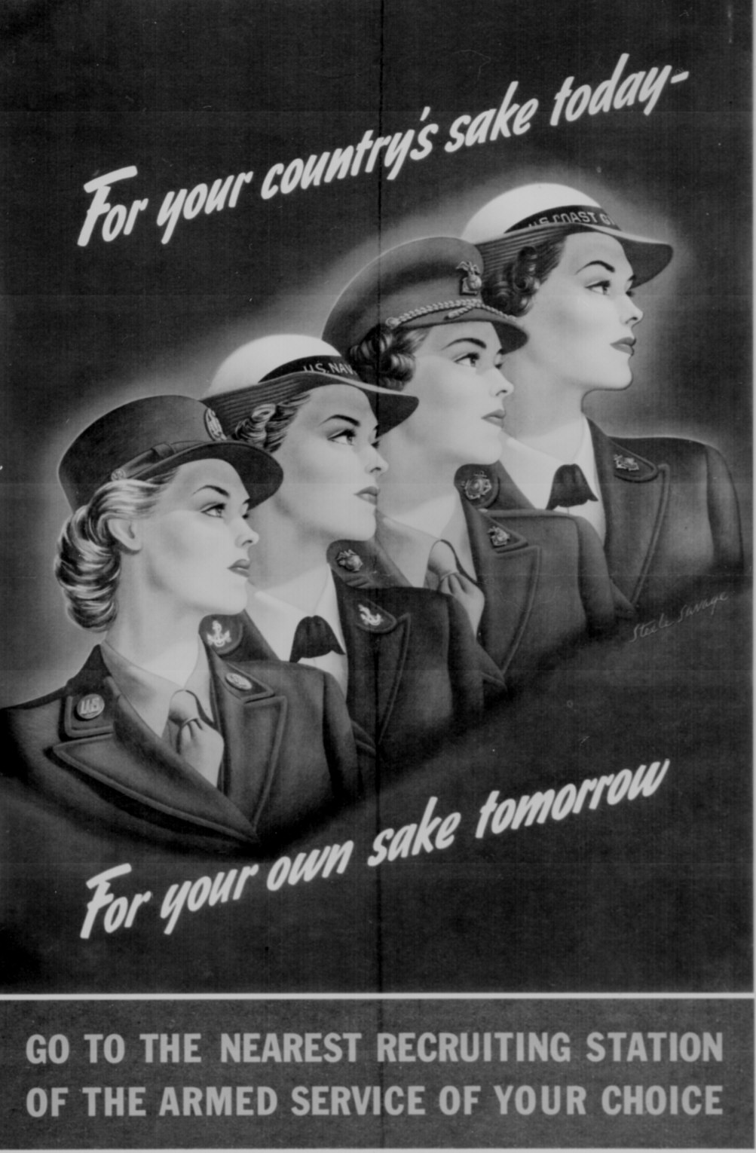

Slide 22
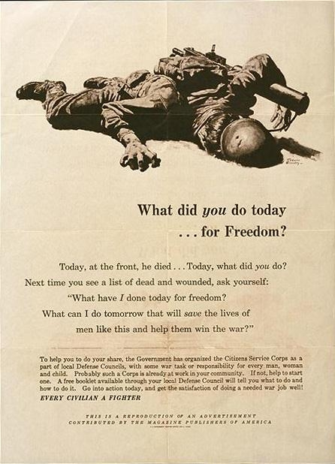

Slide 23
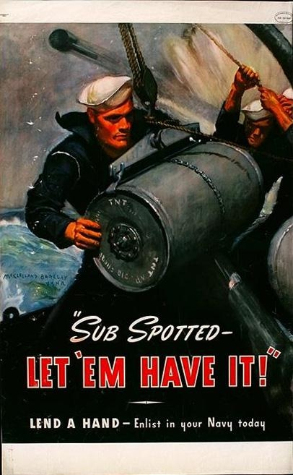

Slide 25
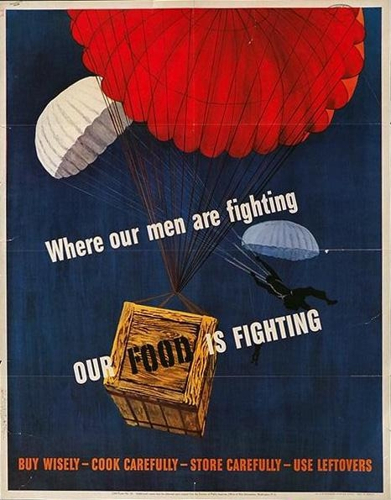

Slide 26
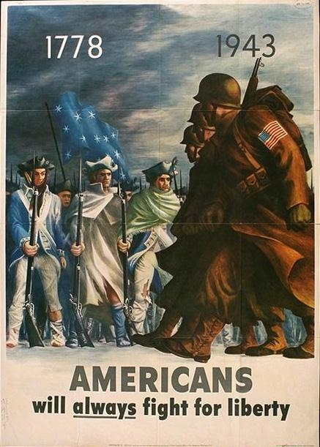

Slide 30
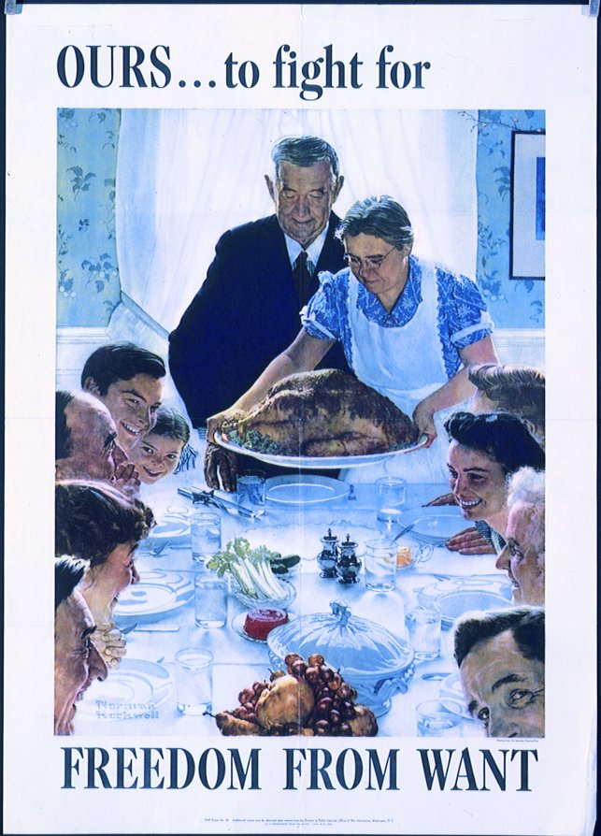

Slide 31
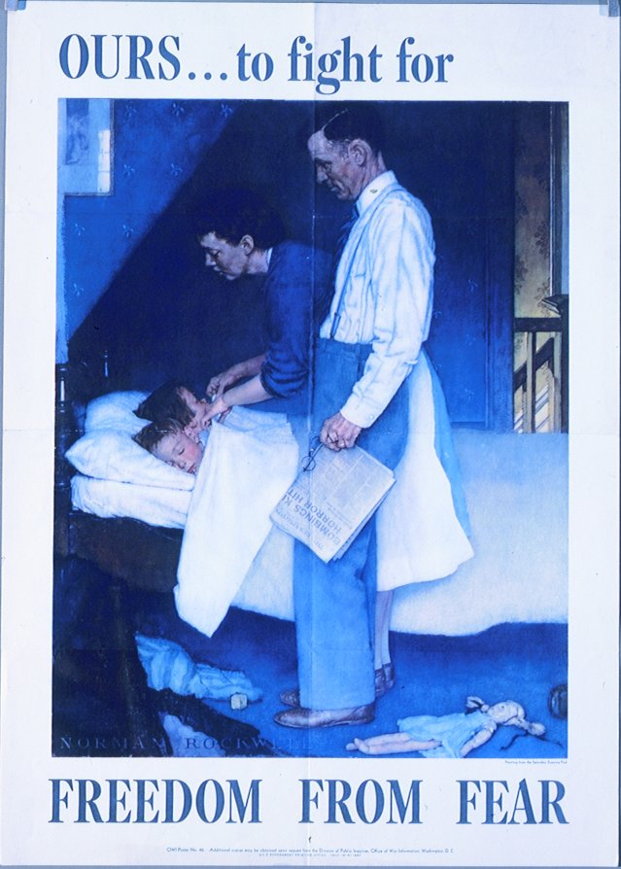

Slide 33
Propaganda Analysis: Choose 4 (5 for EC)
Cartoon Number________ Author (Country) Audience (What group of people is it directed towards?) Purpose (What is it trying to say or get you to do?) Evidence, Support, Outcomes (What do you see or what does it say that backs up your purpose?) Overall Impression and Conclusions (What do you think of it?)

Slide 34
