Slide 1
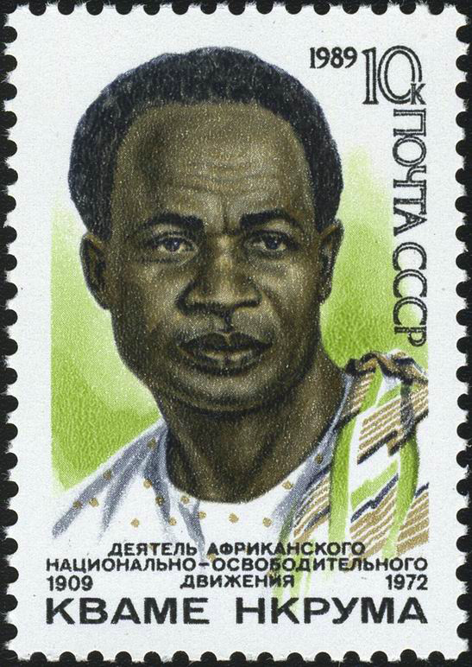
Nationalism Post-1945
Kwame Nkrumah
Nationalist independence leader in British West African colony of Gold Coast
Prime Minister and President of Ghana, 1957-1966

Slide 2
Define: Nationalism
Define the words “state,” “nation-state,” and “country” using www.merriam-webster.com (hint, use definition 5 for state) ****if there are words in the definition you don’t understand, look them up and put the definition in your own words****
Next define “culture”, “ethnic group”, and “ethnicity”
Based on these definitions, is it fair to call the United States a nation-state? Why or why not? Use the definitions to support your answer.

Slide 3
What is nationalism?
Define “Nationalism” in your own words.
What do you think it would mean for the members of a nation to have “nationalist attitudes and feelings?”
In what ways do you think that nationalist attitudes and feelings might promote peaceful interactions towards a common objective?
In what ways do you think that nationalist attitudes and feelings might promote conflict?

Slide 4
Empires & Colonies
Click on this link to a map of the world in 19o0 and answer the questions below.
Identify four imperial states that possessed imperial colonies in 1940 (nations with colonies, look at the key)
For each empire, list as least two colonies that they controlled.
What two continents had the largest number of colonies?

Slide 5
Colonizers’ Perspective
Explain two reasons why an imperialist nation might want colonies. Be sure to explain each reason in detail.
Do you think that the leaders of imperial states would value the importance of social and economic conditions in their colonies? Why or why not?

Slide 6
Revolutions: Peaceful or Violent?
Please read the following statements and complete the questions that follow.

Slide 7
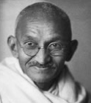
Mohandas K. Gandhi
Mohandas K. Gandhi (1869-1948) led India’s movement for independence from Britain. India became a sovereign state in 1947.

Slide 8
Mohandas K. Gandhi
“Civil disobedience becomes a sacred duty when the state has become lawless or corrupt. And a citizen who barters with such a state shares in its corruption and lawlessness.”
Mohandas K. Gandhi
Source: Mary King, Mahatma Gandhi and Martin Luther King Jr: The Power of Nonviolent Action (Paris:UNESCO, 1999), 286-7.

Slide 9
Mohandas K. Gandhi
Explain this statement in your own words.
What do you think the phrase “civil disobedience” means?
What do you think it means for a citizen to “barter” with a state?

Slide 10
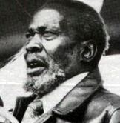
Jomo Kenyatta
Jomo Kenyatta (1894-1978) was the most renowned leader of Kenya’s movement for independence from Britain. He served as Kenya’s first Prime Minister (1963–1964) and President (1964–1978).

Slide 11
Jomo Kenyatta
“By driving the African off his ancestral lands, the Europeans have reduced him to a state of serfdom incompatible with human happiness. The African is conditioned, by the cultural and social institutions of centuries, to a freedom of which Europe has little conception, and it is not in his nature to accept serfdom forever. He realizes that he must fight unceasingly for his own complete emancipation; for without this he is doomed to remain the prey of rival imperialisms, which in every successive year will drive their fangs more deeply into his vitality and strength.”
Jomo Kenyatta
Source: Jomo Kenyatta, Facing Mount Kenya (London: Secker and Warburg, 1953), 317-18.

Slide 12
Jomo Kenyatta
Explain this statement in your own words.
What do you think Jomo Kenyatta’s purpose was in making this statement? Explain why.
Do you agree with the ideas presented in this statement? Why or why not?
Do you think that Mahatma Ghandi would have agreed with Jomo Kenyatta’s statement? Why or why not?

Slide 13
Proclamation of the Irish Republic
Click on the YouTube link and listen to the Irish Proclamation of Independence. This is an examples of a Nationalist Manifesto. Answer the following questions about the Proclamation:
What makes this nationalist?
What are they proposing to do? Why?
Who do you think would have agreed with this more: Kenyatta or Gandhi?
There is text for the Proclamation in the video notes or you can click here to see a text.

Slide 14
Nationalism Manifesto
Imagine you live in a nation with a government that is oppressing you. Write your own Nationalist Manifesto (manifest: a written statement that describes the goals, and opinions of a person or group) based on the Proclamation of the Irish Republic, explaining when you think it is appropriate for a nation to revolt against an imperial ruler. Explain when or if you believe that it is ever appropriate to undertake military resistance as opposed to non-violent resistance.

Slide 15
When you finish:
Go back to the class website and open the document entitled: Information on African and Asian Nations
Use the websites on the document to fill in the two charts.

