Slide 1
How do we learn about the past?

Slide 2
How do your find out what’s going on…
At School?
In the World?
To the parent of..
Notes:
On this slide I ask students to volunteer how they find out about information. The clip art represents some of those sources: teachers, admins, letters, media, internet, etc)

Slide 3
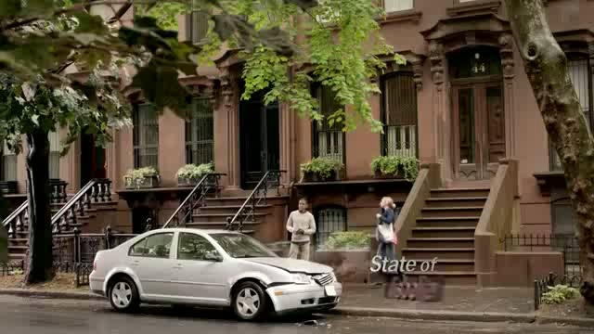
Notes:
This is a commercial that shows how sometimes the evidence that we see or hear may not be accurate. I show this to start a discussion about how we need to research to make sure we can trust the information (State Farm Commercial: State of Disbelief)

Slide 4
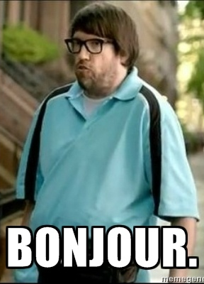
But…How do we know this information is accurate?
Find Evidence
  Written Sources
  Artifacts
  Media
Multiple sources
Authenticate sources
Analyze author’s intent

Slide 5
Written Sources
Primary Sources
Secondary Sources
Firsthand accounts of events/people
Documents, photos, letters, diaries, etc
Created by people who didn’t (or couldn’t) witness event
Biographies, textbooks, Internet, etc
Media: information sources

Slide 6
Artifacts
Objects
Fossils
Anything created/used by humans
Art, tools, weapons, etc
Preserved organic (natural) matter
Human, animal, or plant remains

Slide 7
Who is doing all of this?
Anthropology—the study of humanity, how past and present cultures live
  Culture—a people’s way of life (Beliefs, values, social classes, art, language, tradition, etc…)
Archeology—study of past cultures using artifacts left behind
History—study of past societies/events, primarily using written records

Slide 8
Asking the right questions…
What kind of evidence is this?
What does this object reveal about its owner?
What does it say about the society it came from?
What can we speculate (educated guess based on evidence) about the values, traditions, society, people, climate, etc of where this object can from?
Notes:
These are the right questions that students can ask when they look at artifacts

Slide 9
But what if you’re not sure?
If an object is unfamiliar:
  What is the possible function of this item?
  Why might it have been used?
  Who might have used it?
Beware of:
  Assumptions: guesses made without evidence
  Multiple Perspectives: 2 people can see one object in different ways
  Bias: Making a judgment based on YOUR preferences or beliefs

Slide 10
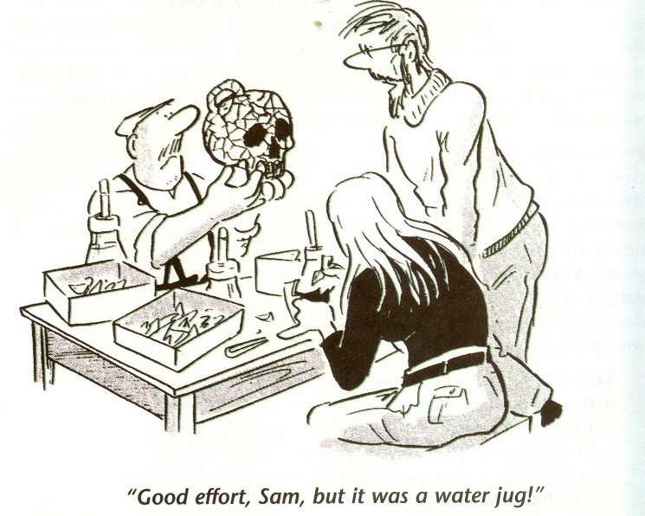
“Good Effort, Sam, but it was a water jug!”
Notes:
I ask students to study this cartoon and ask them what the cartoon is trying to say about making educated guesses. Ideally, you want answers that talk about how much he wanted to pottery to be something “neat” (i.e. a skull) and he believed it despite the evidence (the handle). Try to get them to use vocab words like bias, etc

Slide 11
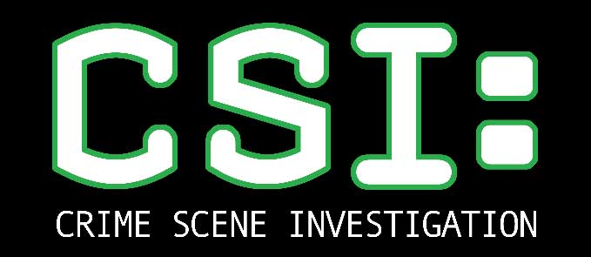
Mohenjo-Daro
Notes:
This goes with the in-class assignment to have students apply the information that you’ve just given them. Students will be asked to look at different artifacts and try to speculate what they could be and what their purpose was. They will study each item and use their charts to answer the following information: Description (features, shapes), Source type (primary, secondary, artifact object), Possible Use or function (how used, who use, etc), Speculations about culture
Do not tell the students what the items are ahead of time.

Slide 12
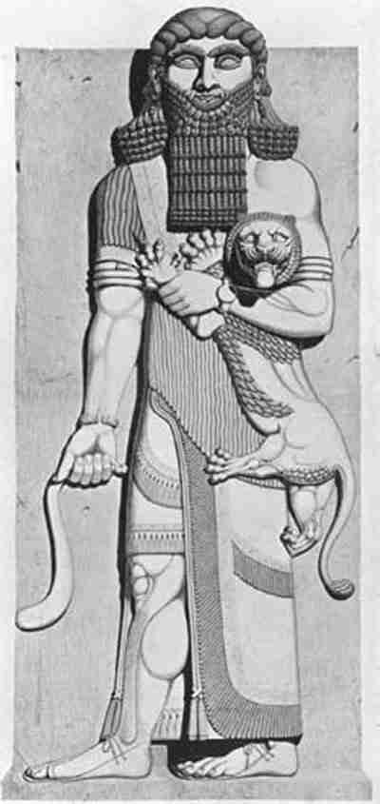
Now let’s apply all of that…
The Epic of Gilgamesh tells the story of the ancient king of Sumer (in Mesopotamia), Gilgamesh, and the long journey he goes on after the world-wide Flood.
As you listen, think about what you can learn about Ancient Mesopotamia.
  Social Classes?
  Government?
  Cities?
  Religion?
  Anything else?
Notes:
Model what they will be doing by reading this quick section of the Epic of Gilgamesh and ask them to think about the things on the slide

Slide 13
Prologue to The Epic of Gilgamesh
I will proclaim to the world of the deeds of Gilgamesh. This was the man to whom all things were known; this was the king who knew the countries of the world. He was wise, he saw mysteries and knew secret things, he brought us a tale of the days before the flood. He went on a long journey, was weary, worn-out with labor, returning he rested, he engraved on a stone the whole story.
When the gods created Gilgamesh they gave him a perfect body. Shamash the glorious sun endowed him with beauty, Adad the god of the storm endowed him with courage, the great gods made his beauty perfect, surpassing all others, terrifying like a great wild bull. Two thirds they made him god and one third man.

Slide 14
In Uruk he built walls, a great rampart, and the temple of the blessed Eanna for the god of the firmament Anu, and for Ishtar the goddess of love. Look at it still today: the outer wall where the cornice runs, it shines with the brilliance of copper; and the inner wall, it has no equal. Touch the threshold, it is ancient. Approach Eanna the dwelling of Ishtar, our lady of love and war, the like of which no latter-day king, no man alive can equal. Climb upon the wall of Uruk; walk along it, I say; regard the foundation terrace and examine the masonry: is it not burnt brick and good? The seven sages laid the foundations.

Slide 15
Your Task
 | 1 | 2…
Source ID # (A.1, A.2, etc)
Description (features, shapes)
Source type (primary, secondary, artifact object)
Possible Use or function (how used, who use, etc)
Speculations about culture (beware of bias!)
In a group, you will be given the picture of an artifact
On your own paper, create and fill in the chart for each artifact
When the timer rings, your group will rotate to the next artifact
If you run short on time, save speculation for later
Each group member must have their own paper.
Notes:
This just explains what they will be doing. You can choose to have the work in groups or individual

Slide 16
Possible Questions to Ask
What kind of person/people might have used this object?
Does it suggest anything about social class, wealth, or the economy?
Did this culture have a written language?
Does this object suggest an education or training?
Did they appreciate art?
Were the peaceful or warring?
What could the purpose of this object be?
Did this culture have a religion?
Did this culture have a government? What kind?
What kind of technology is needed to create this artifact?
What is this object made out of? Is that material natural or manmade?
Is this organic (bone, plant, tooth, etc)? If so, was it altered by man?
Does this tell you anything about where they lived?
Does it say anything about cities, farming, etc?
Notes:
Post these questions on the overhead while they are analyzing their artifacts so they can make sure they are asking the right questions.

